Slide 1
IRSEA
Instituto Regulador dos Serviços de Electricidade e de Água
Evento Paralelo/Side Event 2
Gerenciando a Transição para Combustíveis mais Limpos
(Managing the Transition to Cleaner Fuels)
Palmeiras Suites Hotel, 14 – 15 December 2022, Luanda - Angola

Slide 2
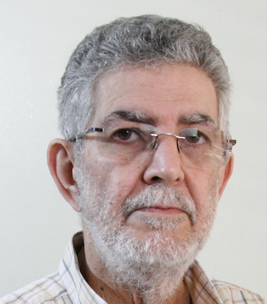
Conferência Anual da RERA
Transição para as Energias Limpas e Renováveis
IRSEA
Biografia/Biography
Nome/Name: JOSÉ de OLIVEIRA
Empresa/company: CEIC/UCAN
Posição/Position: RESEARCHER
Trajectória Profissional/Career Path: Journalist specialized in Economic and Energy Matters from 1975 to 2012; From 1990 to 2012 Executive Editor of Revista ENERGIA, a quarterly Journal on Energy; Researcher for Energy from 2012 to today at CENTRO de ESTUDOS e INVESTIGAÇÂO CIENTIFICA at ANGOLAN CATHOLIC UNIVERSITY (CEIC/UCAN)

Slide 3
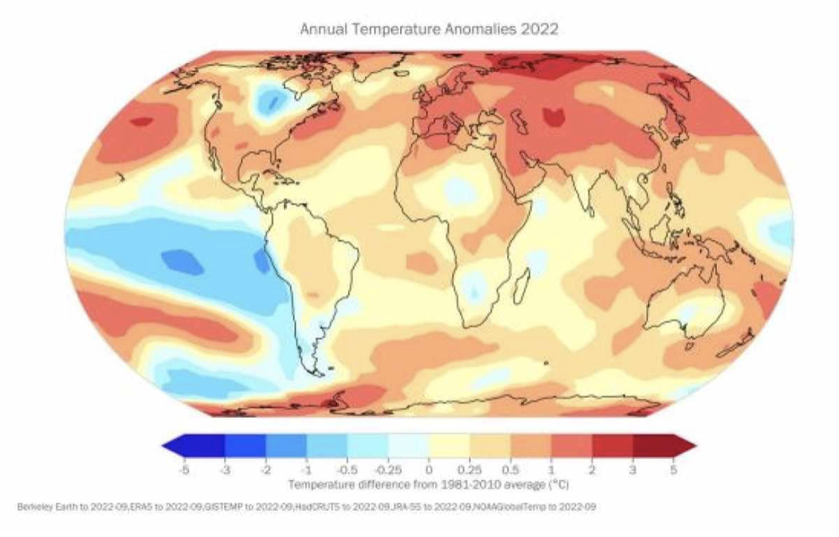
ANGOLA – Affected by High Temperatures
Conferência Anual da RERA
Transição para as Energias Limpas e Renováveis
IRSEA

Slide 4
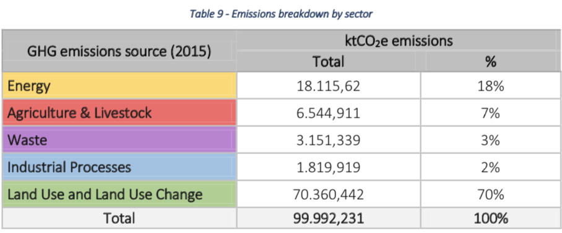
ANGOLA – Emissions Breakdown by Sector
Conferência Anual da RERA
Transição para as Energias Limpas e Renováveis
IRSEA

Slide 5
ANGOLA – Unconditional & Conditional Mitigation Contributions
Unconditional Conditional
15,754 KtCO2/y 26,540 KtCO2/y
Renewable Energy Ongoing Ongoing
Waste Delayed Delayed
Reforestation Partial Partial *
Gas Emissions Delayed Delayed
The Approved Projects for the emissions reduction until 2026 will yield around 14,000 KtCO2/y, corresponding to 89% of the Unconditional Angola commitments in the COP26.
* However, due to Forest losses, estimated at 16% from 1990 to 2020, emissions on this sector are increasing!
Conferência Anual da RERA
Transição para as Energias Limpas e Renováveis
IRSEA

Slide 6
ANGOLA – Generation Capacity & Consumption - 2021
Hydropower 3,700 MW (Available - 97%)
Thermal Power (Diesel) 1,180 MW (Available – 63%)
Year Total Generation 14,000 GWh
(From which Hydro 11,000 GWh (78%)
Top Consumption 2,600 MW
Free Capacity to Export to SAPP 500 to 1,000 MW
Rate of Electricity Access (REA) 42%
REA in Luanda 75% but in BIÉ 8%
2026 Forecast REA 50% +
Conferência Anual da RERA
Transição para as Energias Limpas e Renováveis
IRSEA

Slide 7
ANGOLA – Energy Transition Effective Steps
ANGOLA is investing:
Second biggest Hydropower plant in the country – CACULO CABAÇA concluding in 2026
Solar and small Hybrid Solar (Diesel) plants to attain around 500 MW in 2025. (280 MW near completion)
Revamping 2 old Hydropower plants – 74 MW
High and Medium Tension Transport Power Lines
Pre-Paid Electricity Meters to improve Power Companies Revenues
Conferência Anual da RERA
Transição para as Energias Limpas e Renováveis
IRSEA

Slide 8
ANGOLA – Government Needed Actions Until 2030
Conferência Anual da RERA
Transição para as Energias Limpas e Renováveis
IRSEA
Steadily Increasing Gasoline and Diesel prices
Equally increasing Kilowatt/hour Tariff in order to support the Operational Costs of Power companies
Increasing Diesel quality to lower % sulphur
Increasing Customs Tax for the high consumption Autos

Slide 9
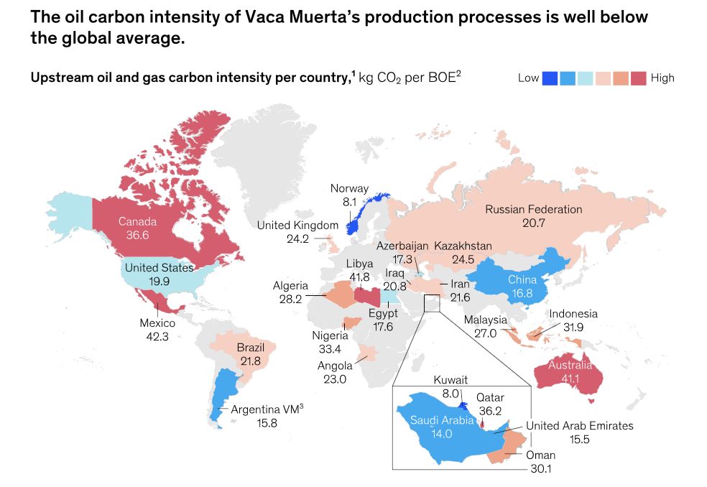
WORLD – Oil & Gas Production Carbon Intensity
Conferência Anual da RERA
Transição para as Energias Limpas e Renováveis
IRSEA

Slide 10
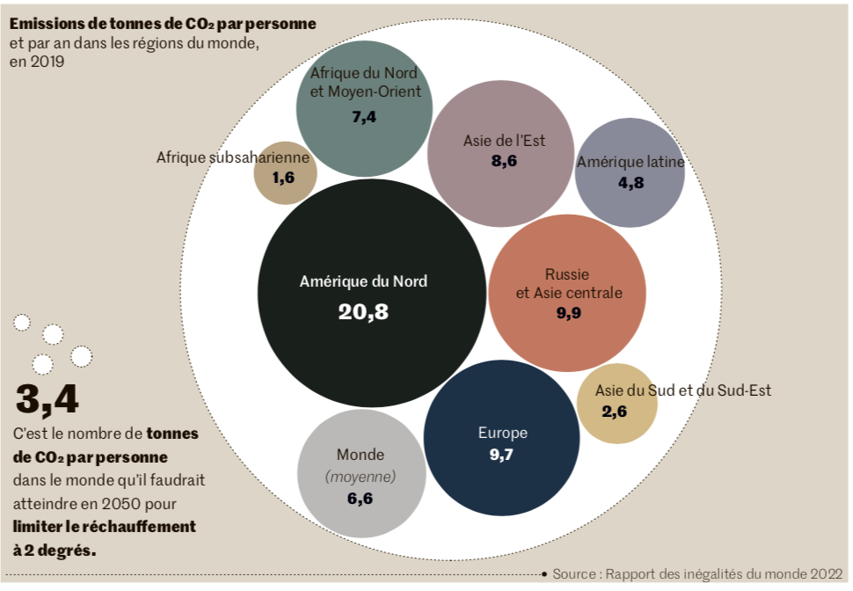
AFRICA – The Lowest Polluter Continent
Conferência Anual da RERA
Transição para as Energias Limpas e Renováveis
IRSEA

Slide 11
Logotipo Entidade/orador
Conferência Anual da RERA
Transição para as Energias Limpas e Renováveis
IRSEA
Thank You Obrigado Merci Beaucoup Asante Sana

