Slide 1
Decarbonization of the Transport Sector through the adoption of Hybrid and Electric Vehicles
CEO ZERA
15 December 2022

Slide 2
Presentation Layout
Vehicle standards/trades
Charging station standards
EVSE/Buildings standards
Import duty of vehicles and EVSE
Licensing/taxes’
Training & Development
Solar PV Support
Public Awareness

Slide 3
Vehicle Standards
Vehicle standards to be in line with international trends.
ISO 6469-2:2018 :Electrically propelled road vehicles — Safety specifications — Part 2: Vehicle operational safety
ISO 6469-3:2018: Electrically propelled road vehicles — Safety specifications — Part 3: Electrical safety
ISO 6469-1:2019
Electrically propelled road vehicles — Safety specifications — Part 1: Rechargeable energy storage system (RESS)

Slide 4
Vehicle Standards
Import of EV’s must conform with requirements of SI 124 of 2020 - Control of Goods (Open General Import Licence) Standards Assessment—Consignment Based Conformity Assessment (CBCA) Notice, 2020 (No. 1).

Slide 5
Charging Station Standards
The Authority has developed and published the following electric standards;
IEC 61851-1:2017 Electric vehicle conductive charging system - Part 1: General requirements
IEC 61851-21-1:2017 Electric vehicle conductive charging system - Part 21-1 Electric vehicle on-board charger EMC requirements for conductive connection to AC/DC supply
IEC 61851-21-2:2018 Electric vehicle conductive charging system - Part 21-2: Electric vehicle requirements for conductive connection to an AC/DC supply - EMC requirements for off board electric vehicle charging systems
IEC 61851-23:2014 Electric vehicle conductive charging system - Part 23: DC electric vehicle charging station
IEC 61851-24:2014 Electric vehicle conductive charging system - Part 24: Digital communication between a d.c. EV charging station and an electric vehicle for control of d.c. charging.

Slide 6
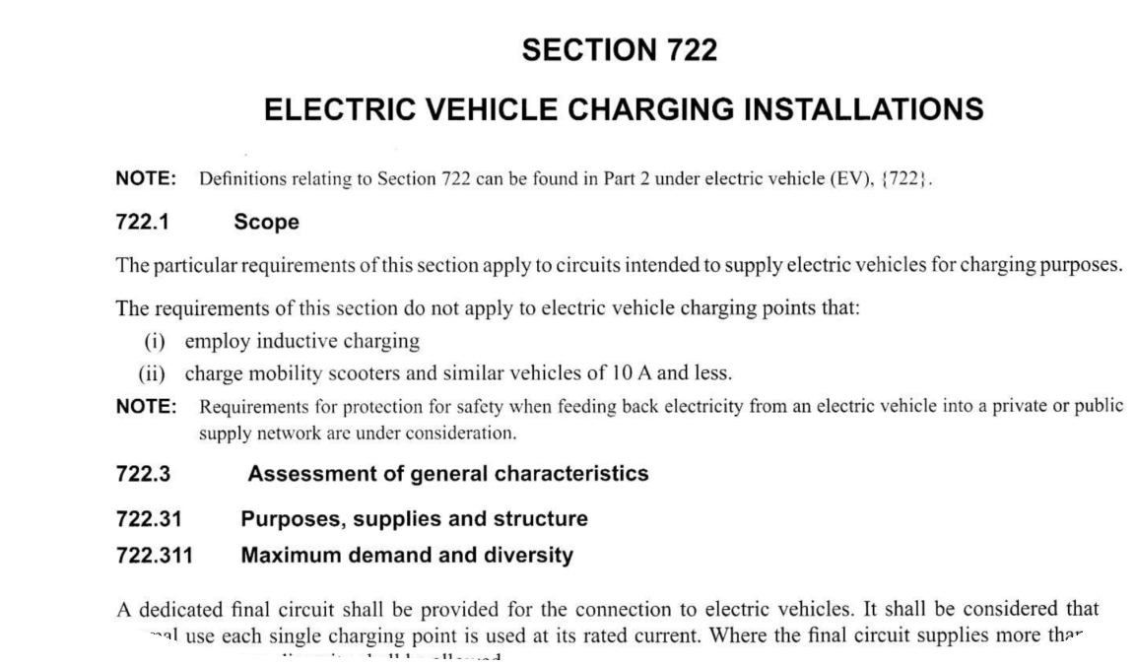
Buildings Standards
The Authority expects all buildings where EVSE is installed to adhere to the ZWS400 Electricity Regulations Standards.
The standard is being aligned to the current BS7671:2018 IET Wiring Regulations (18th Edition) which articulates on charging stations under section 722;

Slide 7
Import Duty of EV’s and EVSE
Fiscal incentives expectations are as follows;
Duty rates modification for EV’s and EVSE to stimulate/increase sector growth
Duty and excise duty exemption

Slide 8
Commercial Incentives
These include the following;
Preferential licensing by local councils
Rebates on tolling fees
Registration cognisant of EV’s e.g. kW vs cc (engine size)
Unique number plates for EV’s

Slide 9
Training and Development/ R&D
Learning institutions are expected to modify their syllabi to cater for EV servicing and repair training
Need to utilise locally available lithium for battery manufacture – beneficiation
Local research into EV’s adoption encouraged

Slide 10
Solar PV Support
Encourage installation of Solar PV systems for EV owners (less reliance on supply from dirty sources)
Encourage participation in net metering scheme for same
Promote vehicle to grid (V2G) for EV owners for grid support
(Vehicle-to-grid technology – V2G is the process of feeding the energy stored in an EV battery back into the ZETDC network/grid. This is a game-changing new technology that has the potential to transform the energy system as we know it.)

Slide 11
Public Awareness
To educate the public on environmental awareness and the economic & ecological benefits of electric vehicles through the conduct of and/or participation in promotional activities
To accelerate the society’s conversion from petroleum powered vehicles to electric vehicles
To educate players in the fuel supply industry to commence installation of EVSE at service stations
To promote installation of EVSE at food courts, shipping malls etc.

Slide 12
Expectations Summary
Standards development for EV’s and EVSE
Duty/Excise rates reduction
Adoption of commercial incentives – update of registration system
R&D Intensification
Sector training and development
Nationwide dispersal of charging stations
Increased public awareness
Adoption of V2G
Participation in Net metering scheme

Slide 13
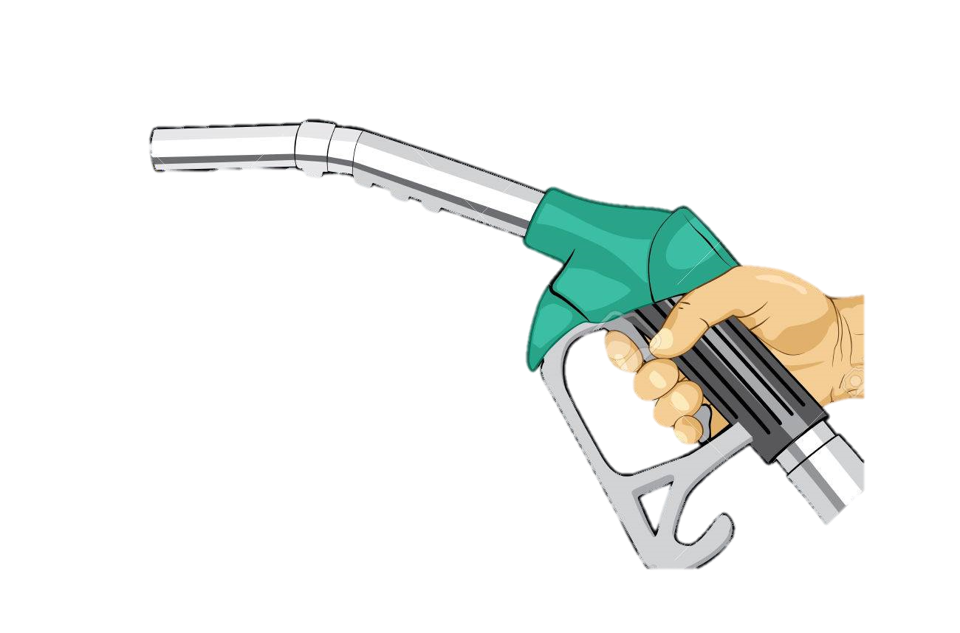
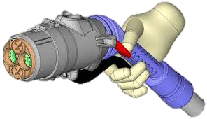
THE END
Let us all embrace E-mobility.

Slide 14
Thank You
For sustainable energy
45 Samora Machel Avenue,
14th Floor Century Towers Harare
Tel: +263 4 780010, 253461 and 799797
Email: admin@zera.co.zw,
Web: www.zera.co.zw
Facebook: ZERAenergy Twitter: @ZERAenergy
Toll free line: 08080136 (Econet); 0713 780, 010 (Telecel); 08010070 (NetOne)
Whatsapp +263772161966

