Slide 1
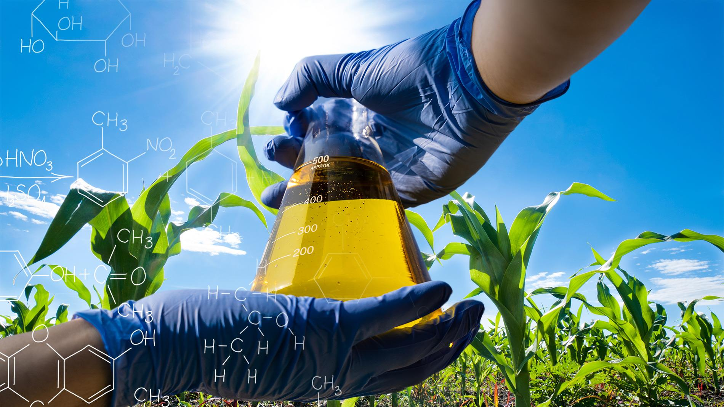
Challenges and Perspectives of Biofuels in Angola
DECEMBER, 2022

Slide 2
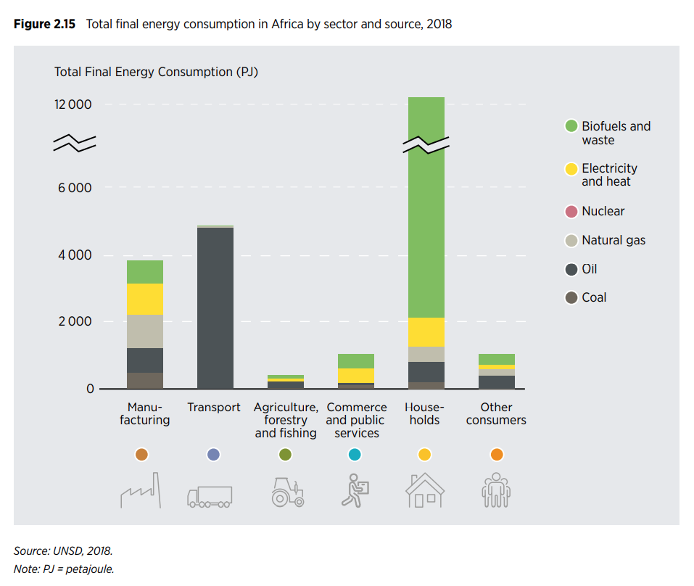
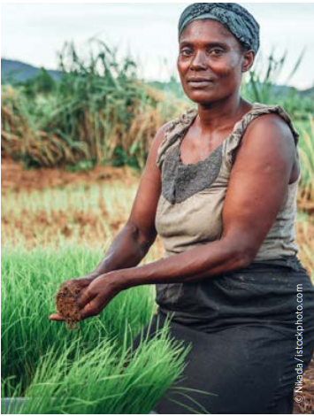
Challenges and Perspectives
Figure 1:
Notes:
Os biocombustíveis (biomassa, resíduos, etc.) são fontes energéticas mais usadas no continente

Slide 3
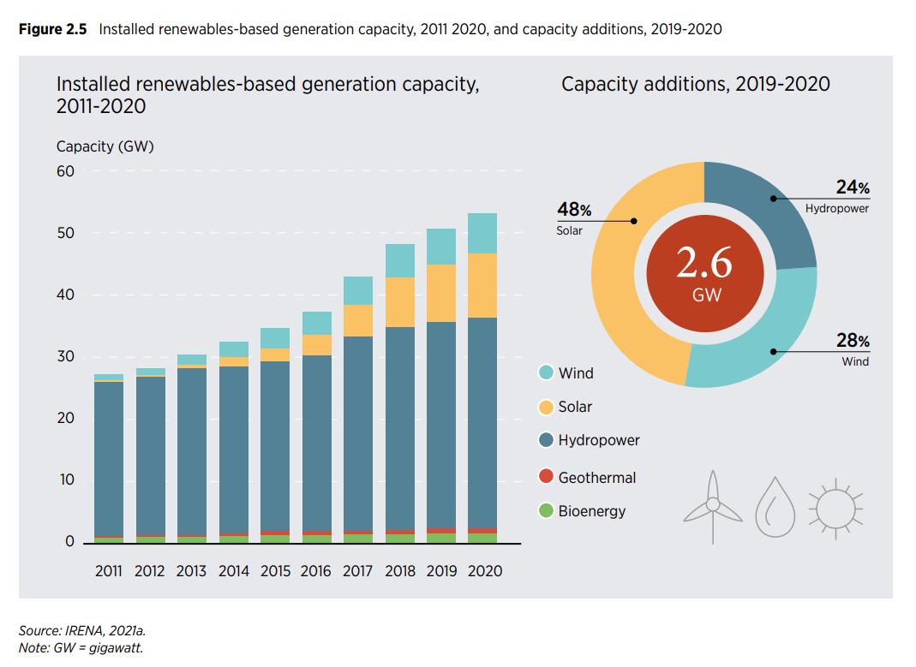
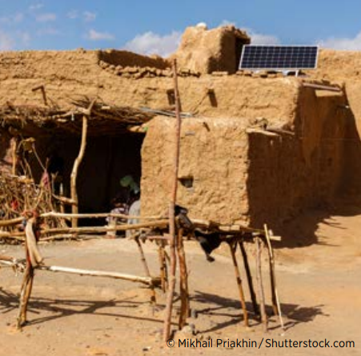
Challenges and Perspectives
Figure 2:
Notes:
O investimento realizado nos últimos 3 anos em África, mostra uma tendência mais para energia solar, eólica e hídrica. Mesmo no lugar mais remoto outras fontes industrializadas são usadas menos os biocombustíveis

Slide 4
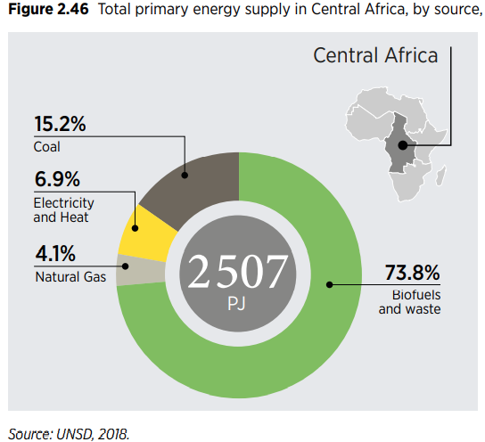
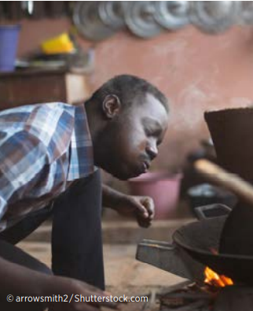
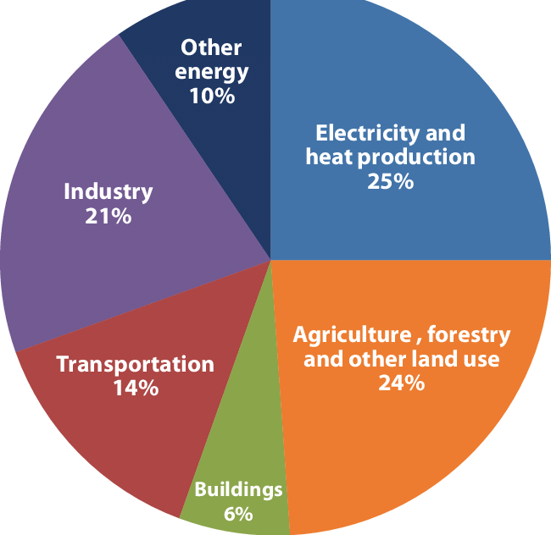
Challenges and Perspectives
Figure 3: Total primary energy supply in Central, by source
Figure 4:Global greenhouse gas emissions by sector (Fonte: Research Gate)
Figure 3:

Slide 5
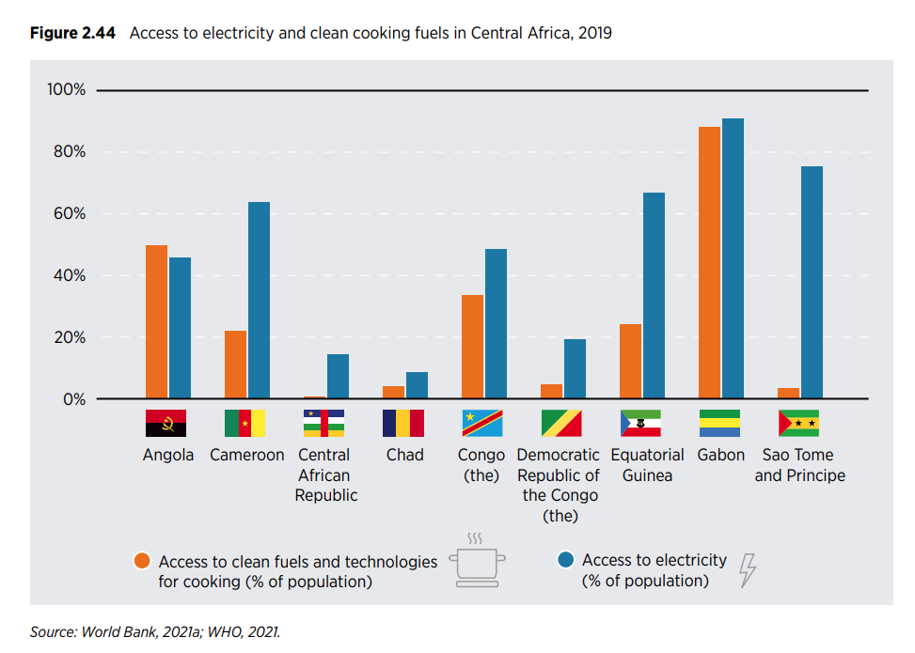
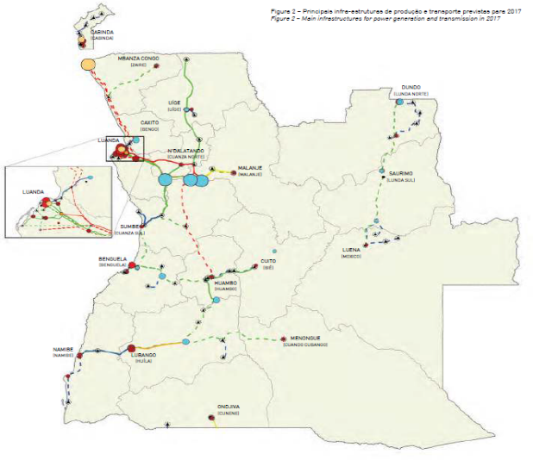
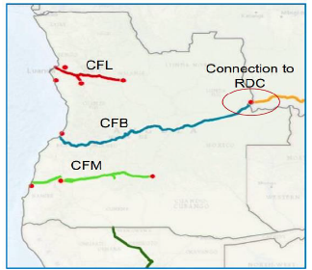
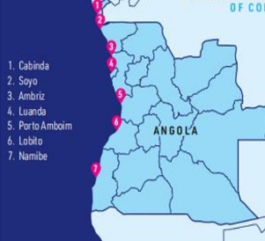
Challenges and Perspectives
Figure 5:

Slide 6
Challenges and Perspectives
LEGISLATION AND REGULATIONS;
AVAILABILITY AND ACCESS TO LAND;
SELECTION OF BIOMASS FOR BIOFUEL PRODUCTION
INFRASTRUCTURES, LABORATORIES AND BIOREFINARIES;
DEMAND/SUPPLY AND MARKETING
QUALIFIED HUMAN RESSOURCES

