Slide 1
Southern Africa Energy PROGRAM (SAEP)
Challenges and options for transitioning to cleaner fuels
RERA CONFERENCE, LUANDA, ANGOLA
15 October 2022

Slide 2
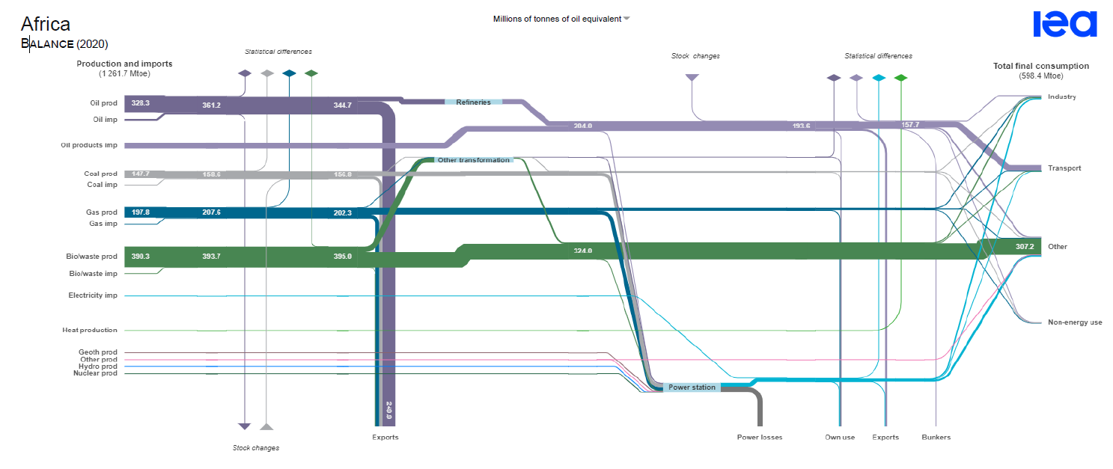
Continental energy balance – supply and demand

Slide 3
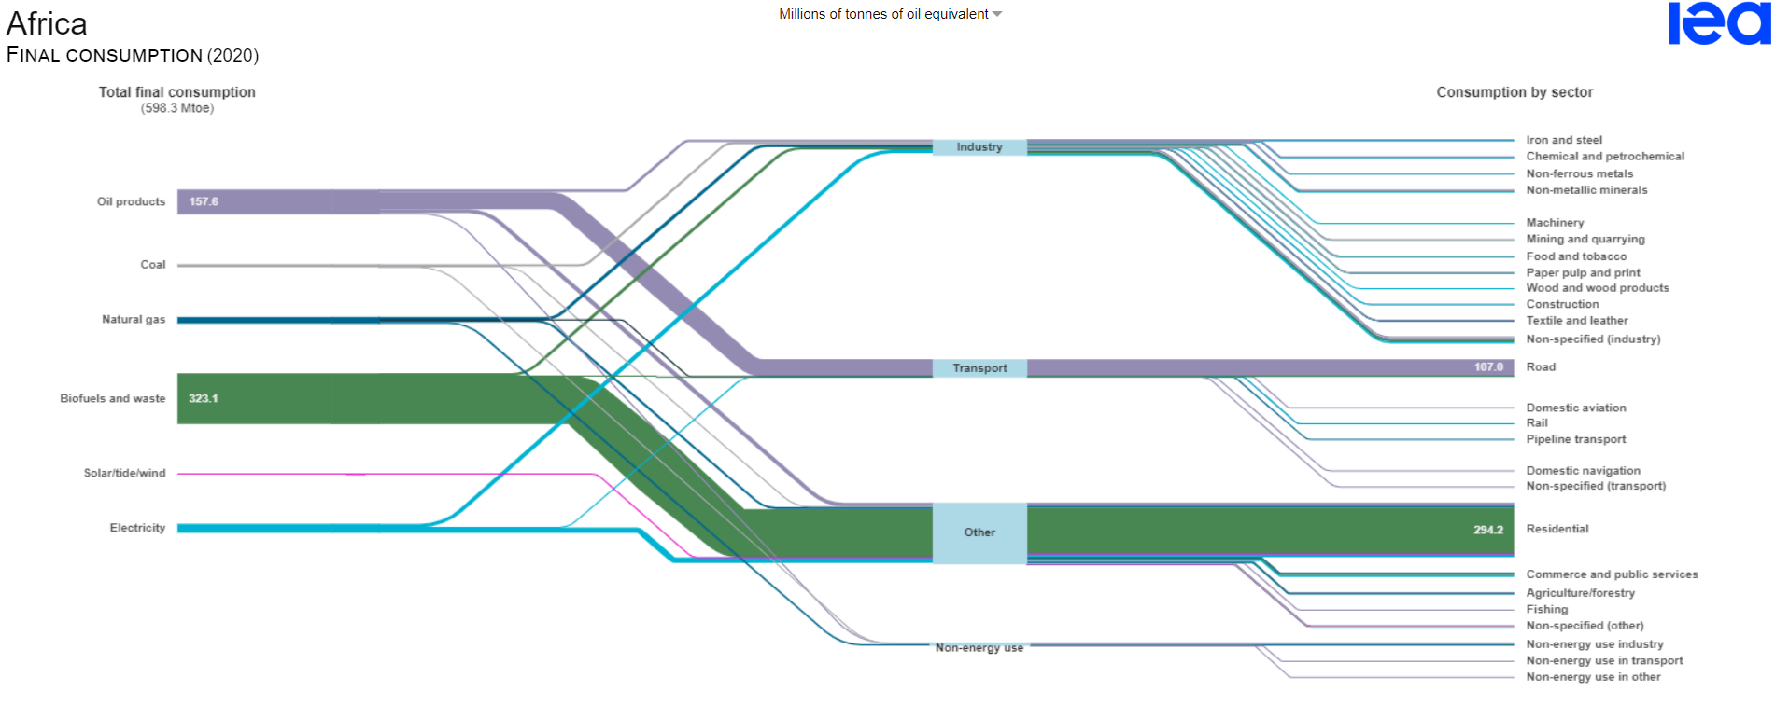
Final consumption of energy

Slide 4
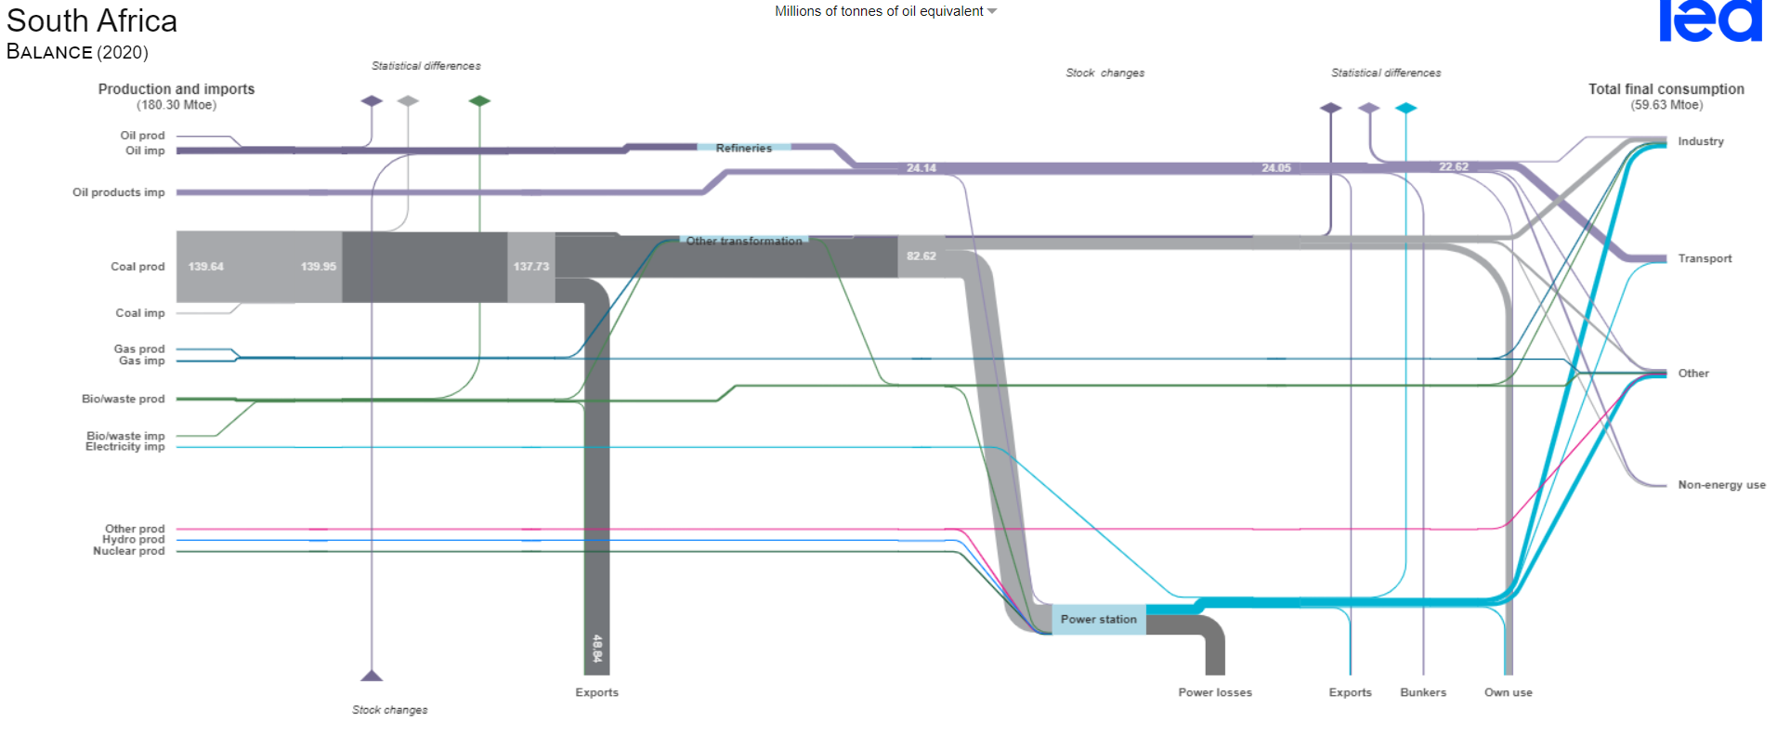
Sample of biggest economies on the continent (1/3)

Slide 5
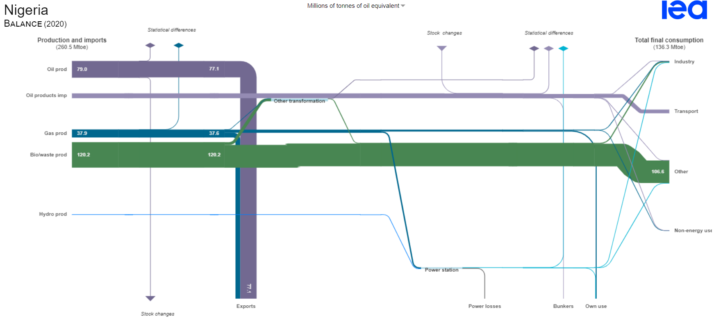
Sample of biggest economies on the continent (2/3)

Slide 6
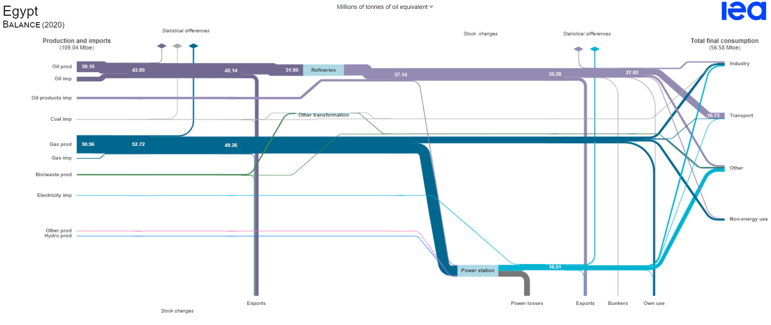
Sample of biggest economies on the continent (3/3)

Slide 7
CO2 EMISSIONS PER FUEL TYPE
Power station coal
Solid biomass: 118,17-93,80
Biomass gas: 52,07

Slide 8
Electricity options and challenges
Primary Fuel | Clean Alternative | Opportunities | Challenges
Coal and oil products | Renewable energy | Rapid deployment Innovation in the wind and energy technology space is still accelerating to capture efficiencies and improve load factors Project development is well understood and investors are confident about returns in most markets Low penetration of renewable energy on the African continent represents a significant opportunity | Grid integration challenges Governments increasingly unable to derisk investments Availability of local skills for EPCO&M Absence of mature markets Challenge from vested interests
 | Hydropower | Significant resources that remain untapped | High capital requirements Environmental compliance requirements Specialist skills technology Climate change
 | Energy storage systems | Competition among technologies is driving rapid innovation and commercialisation Procurers are beginning to understand the different technologies Price points of BESS chemistries on a downward slope | High skills technologies Lots of misinformation on the real state of development of some technologies Still not competitive (partly due to regulatory contraints) Environmental impact concerns
 | Nuclear energy | Zero emissions technology | Very high capital requirements and regulation is complex Notorious for running over time and budget Social anxiety around technology Environmental and safety concerns High specialist skill technology
Natural Gas | Same options as above Considering of gas as a transition or step-down fuel | Approximately half the emissions of coal Gas power plant is very flexible and dispatchable - ideal for supporting a switch to a green grid Short development cycle Well-understood technology | Fierce debate on the "cleanness" of gas Fuel price risk: Dollar indexation etc. Value chains and infrastructure not developed

Slide 9
transport options and challenges
Primary Fuel | Clean Alternative | Opportunities | Challenges
Oil products | "Green" electricity | Rapid innovation due to private sector driven dvelopment and government commitment | Distance range of vehicles Supporting infrastructure Low levels of commercialization Vested interests
 | CNG/LNG | Research interest in the technology and some pilot projects in operation | Fuel supply issues Underdeveloped value chains A natural gas technology

Slide 10
Obrigado, Thank you!

