Slide 1
UNIPOWER
The impact of renewable energy on power quality
Russom Kebedom
Export Area Manager
Unipower AB
www.unipower.se
Russom.kebedom@unipower.se
voltage
current

Slide 2
Outline of the presentation
Presentation of Unipower
What is Power Quality compliance
Power system
Expected PQ problems after integration of renewable
Frequency Instability
Voltage instability
When to start measuring
Some international cases
Cost of bad PQ

Slide 3
Unipower – Power Quality Experts
Market leading technology World class instrument design and database architecture
Smart Grid Cloud server solutions
PQ Secure System Automated solutions from 20 years historical overview to real-time
Member of WG IEC 61000-4-30 Class A
Strong financials AAA
ISO 9000 and IEC 62586
Products in over 80 countries 30 years in market

Slide 4
Our sales and distributors worldwide...

Slide 5
Unipower Some of our references

Slide 6
What is Power Quality compliance?
It is the electrical network´s ability to supply a clean and stable power flow:
The power supply that is always available,
Has noise/distortion-free sinusoidal
wave shaped voltage
And it is always within prescribed voltage and frequency tolerances
PQ status
Power factor
Harmonics
Voltage dips
Interruptions
Transients
Flicker
Unbalance

Slide 7
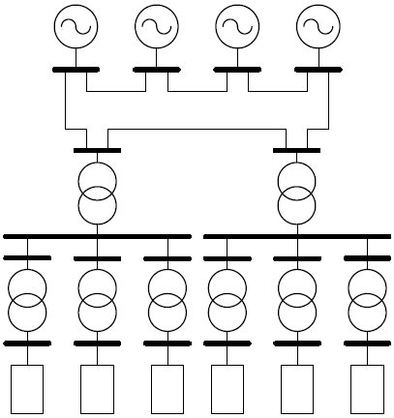
The traditional power system
Known power flow direction
Vertical structure
Big power plants feed into
the transmission grid
Notes:
The most severe power quality problems started to appear at the beginning of the 1950’s. This was due to the development of transistors which lead to non-linear loads in the power network. Computers, printers, and all other power electronic products represent non-linear loads.

Slide 8
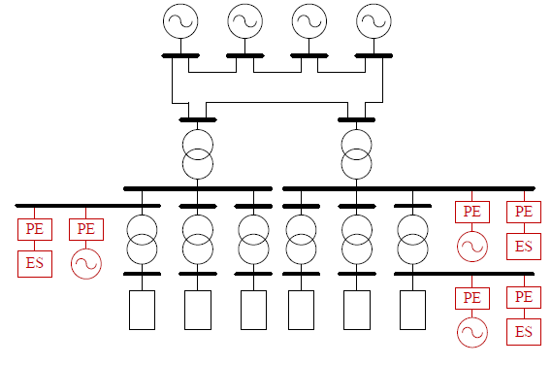
The “modern” power system
Deregulation and increased focus on sustainability lead to new scenario
Bi-directional power flow
Notes:
The most severe power quality problems started to appear at the beginning of the 1950’s. This was due to the development of transistors which lead to non-linear loads in the power network. Computers, printers, and all other power electronic products represent non-linear loads.

Slide 9
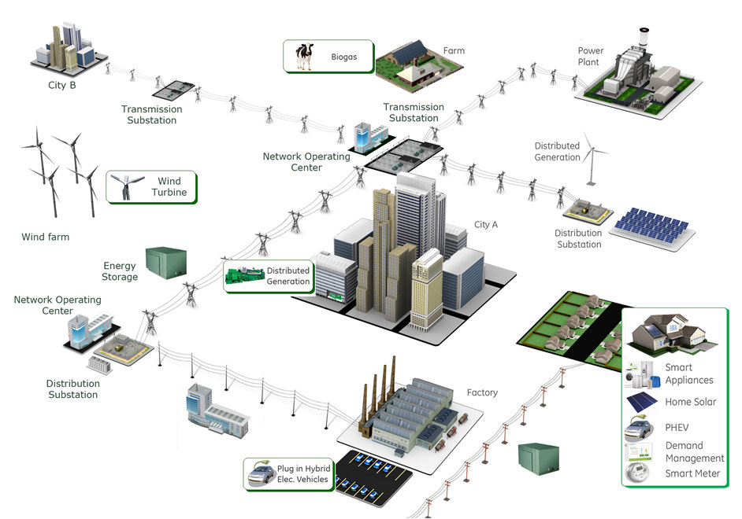
Towards the SmartGrid concept
Notes:
The most severe power quality problems started to appear at the beginning of the 1950’s. This was due to the development of transistors which lead to non-linear loads in the power network. Computers, printers, and all other power electronic products represent non-linear loads.

Slide 10
Why renewable energy?
Centralized Power generation system are going through constraints of shortage of fossil fuel and need to reduce carbon emission
Worldwide awareness about Not R-energy resources, carbon footprint reduction encourages for renewable distributed energy generation
As renewable generations penetration are increasing in complex grids, Power Quality issues of medium and low voltage power transmission system are becoming challenging and interesting.

Slide 11
Challenges with Renewables
Unstable/Variable nature
Renewables “are not expected” to contribute to the control of Voltage or Frequency.
Normal & contingency operations
Transient & Dynamic Voltage stability

Slide 12
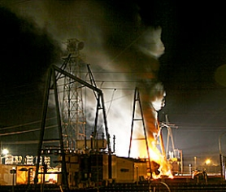
Challenges with Renewables, continue
The increasing penetration rate of RES in the power systems is raising technical problems as
Voltage regulation
Network protection coordination
Islanding
Power quality
Due to the output power variations of wind turbines, voltage fluctuations are produced
Power electronics converter together with operation of non- linear appliances inject harmonics to grid which should be within stipulated limit

Slide 13
Challenges with Renewables, continue
In addition to the voltage fluctuation due to irradiation cloud cover or shading effect could make PV system generation unstable
The capability of the power system to absorb this perturbation is dependent on the fault level at the point of common coupling
Moreover, PV inverter is not able to meet the grid requirement of reactive and Harmonic currents drawn by non –linear loads
These problems must be quickly solved in order to fully exploit the opportunities and benefits offered by the RES technologies.

Slide 14
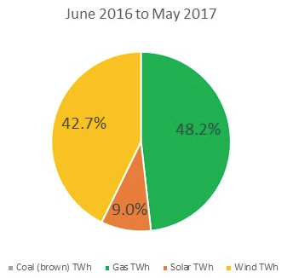
South Australia Blackouts in 2015-2017
AEMO releases final report into SA blackout, blames wind farm settings for state-wide power failure
The final report finds that the state’s windfarms rode out the grid disturbances prompted by the loss of key transmission lines during two tornadoes with wind speeds between 190 and 260 km/h – but the activation of a protection mechanism in the turbines triggered a sustained reduction in power in the state, with a drop of 456MW over a period of less than seven seconds.
The sudden reduction in wind power on the day of the blackout prompted a significant increase in imported power flowing through the Heywood interconnector, which then tripped the whole system and triggered the state-wide blackout on 28 September.
The market operator says “the intermittency of the wind was not a material factor in the black system event itself” but it says the impact of the sudden drop in power due to the in-built protection mechanisms was “greater than expected”.
AEMO=Australian Energy Market Operator
The Australian Energy Market Operator
has predicted that South Australia will reach 73 per cent renewable energy by 2020/21

Slide 15
South Australia Blackouts in 2015-2017
There are three observable reliability impacts from the installation of
high intermittent renewable generation in South Australia:
First, moving towards a high intermittent renewable generation system requires much greater planning and co-ordination than we have seen in SA. Many of the reliability events could have been avoided or mitigated with better co-ordination. Of course, this is easy to say with the benefit of hindsight. We only learnt these painful but valuable lessons because of repeated system failure.
Second, the interventions made by AEMO demonstrate the importance of having adequate supporting local generation or other matching technologies available at the times when they are needed. All generation (renewable and thermal) and transmission technologies will experience unexpected faults. It is the ability of the system to respond quickly and adequately that prevents or mitigates the reliability impacts of such events.
Third, the SA experience suggests we may need to think differently about transmission in the future. It is telling that AEMO is now seeking to constrain the interconnector at times when there is a risk of the state being islanded. Increasing the use of transmission in the future is a strategic question. Investment in new transmission may find it is competing with investment in local storage technologies to complement greater intermittency in generation.
AEMO=Australian Energy Market Operator

Slide 16
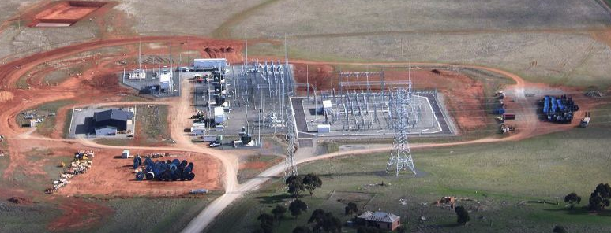
Tesla battery
The 100 MW output of the Tesla battery might appear small compared to South Australia's peak energy demand of about 3000 MW, but its ability to quickly inject electricity within a fraction of a second is a large factor in its success.
AEMO is now working on a new protection scheme, and Tesla's big battery will play a part.
It aims to detect high flows on the interconnector and trigger the battery to start discharging its full output as quickly as possible, while shedding power to homes and businesses if required.
And future batteries could also be a part of the scheme in the future.
AEMO=Australian Energy Market Operator

Slide 17
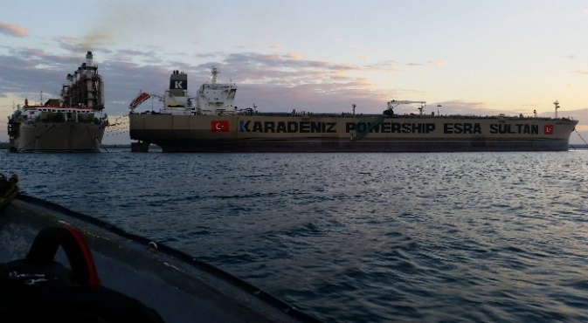
Why to measure Power Quality
As Every product quality need to be measured and quantified, power should …
During new generator installations in the network, the network owner should produce a background power quality level report for the point of connection or nearest to the point of connection.
Regulatory requirements
Customer relationship
Save Money
Installation at karpowership

Slide 18
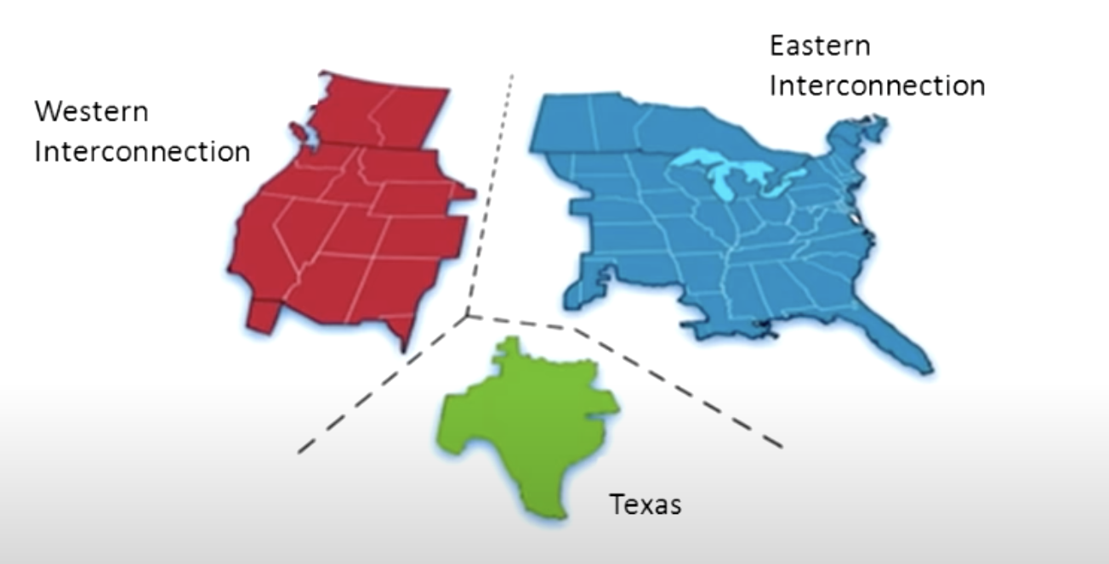
Black out in Florida due to frequency instability created by Renewable Energy Sources

Slide 19
Black out in Florida due to frequency instability created by Renewable Energy Sources

Slide 20
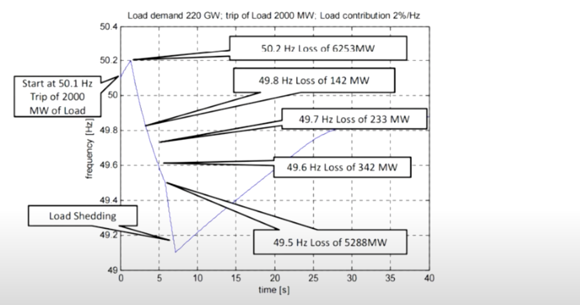
Frequency instability created by Renewable Energy Scores In Germany

Slide 21
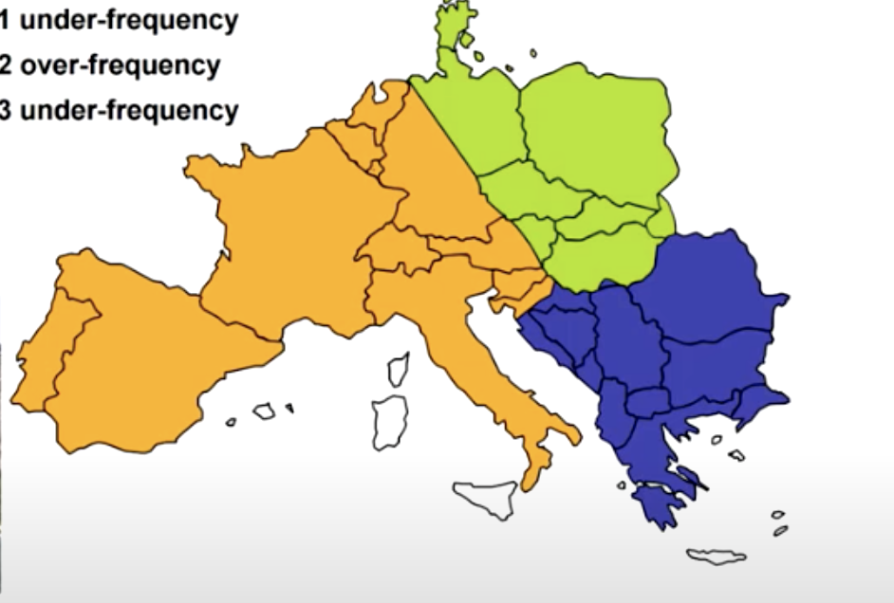
Low Inertia created by Renewable Energy Scores In EU
3
1
2

Slide 22
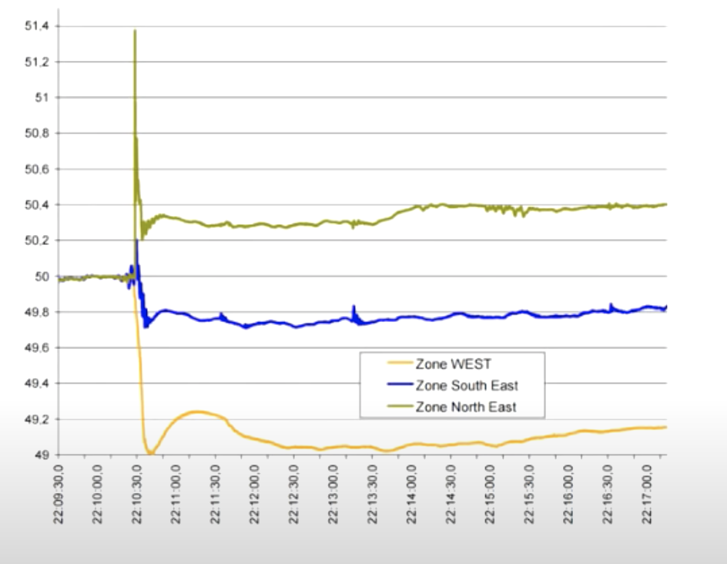
Low Inertia created by Renewable Energy Scores In EU

Slide 23
Consequences and financial modelling of PQ problems
Berkeley Lab Study Estimates $80 Billion Annual Cost of Power Interruptions … Research News, Berkeley Lab, February 2, 2005
$50 billion per year in the USA is lost as a results of power quality breakdowns …. Bank of America Report
A manufacturing company lost more than $3 million one day in Silicon Valley when the “lights went out.” … New York Times January 2000
“A voltage sag in a paper mill can waste a whole day of production - $250,000 loss” … Business Week, June 17,, 1996
Half of all computer problems and one-third of all data loss can be traced back to the power line … Contingency Planning Research, LAN Times

Slide 24
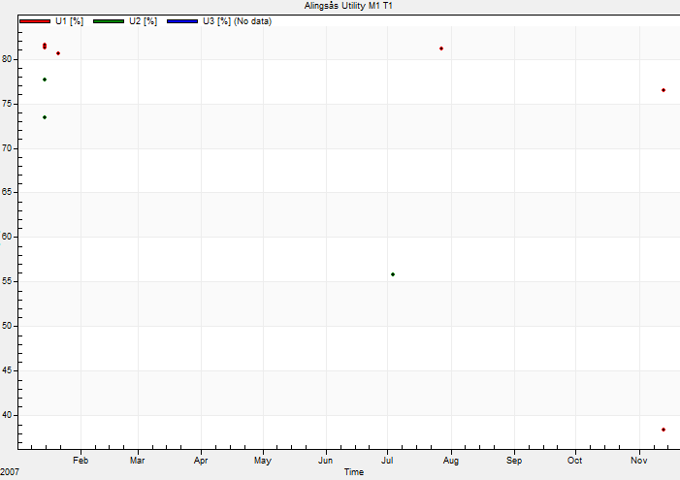
EU poor power quality
An economic impact > 150bn Euro
… Jonathan Manson presents the results of a survey conducted by the European Copper Institute (ECI) into the consequences of poor power quality for EU industry. These add up to > 150bn Euro annually, are mainly experienced by industry and caused by power interruptions (dips, surges, transients and short duration interruptions) …
Source: http://ezine.leonardo-energy.org/e_article001023690.cfm
One year data (8 dips)

Slide 25
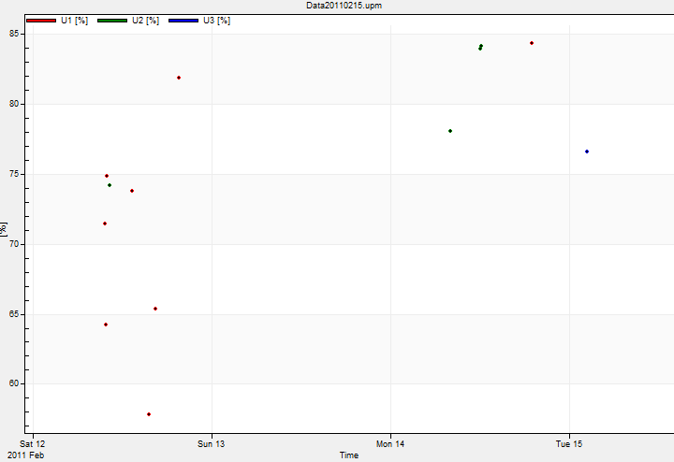
The poor power quality in Africa
in comparison with that the EU
Four days data (12 dips)
What are the costs?

Slide 26
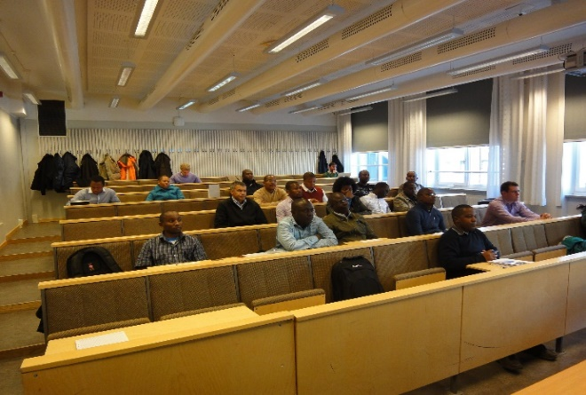
Knowledge Transfer/Exchange
Training session at KGTC
October, 2022
Planned training session at KGTC March 2023

