Slide 1
SADC Secretariat-
Energy Division
Development of SADC Regional Gas Master Plan 2023- 2038
15 December 2022
Prepared by Moses Ntlamelle

Slide 2
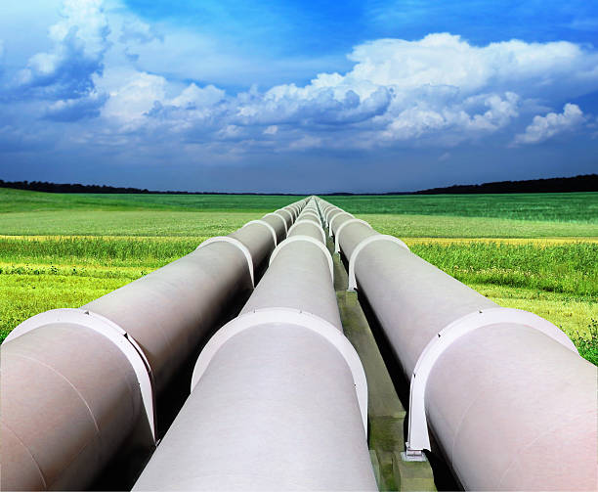
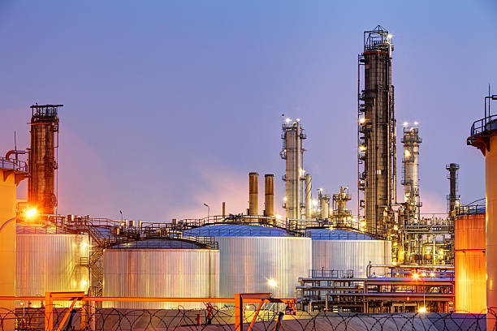
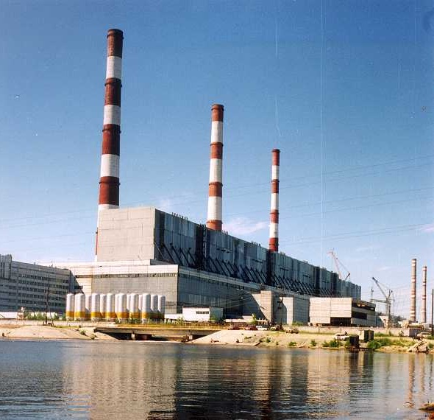
Presentation Outline
Introduction and Overview of SADC
Energy Programme Objectives
SADC Energy sector Priorities
Energy Sector Instruments
Energy Reporting Structure
Overview of Regional Power generation Mix
Background on RGMP Development
Analysis on Gas for Industrialisation
Regional Gas Hard Infrastructure and Planned Projects
Enabling Dimensions for RGMP
Role of RERA and Other Organisations RGMP
Conclusions and the Way forward
2
Notes:
2

Slide 3
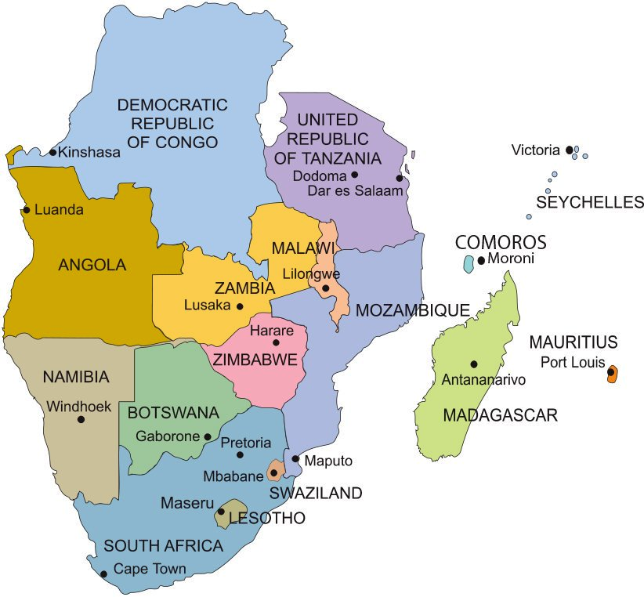
SADC Member States
SADC was established as a development coordinating conference (SADCC) in 1980 and transformed into Southern African Development Community (SADC) in 1992.
It is an inter-governmental organization 16 Southern African Member States as at August 2017.
Combined Population of close to 390 million Inhabitants

Slide 4
SADC Energy Sector Plan Conceptual Framework

Slide 5
SADC Energy Programme
SADC Energy Programme Objective - to facilitate and coordinate and achieve availability of sufficient, reliable, least cost energy services that will assist in the attainment of economic growth, industrialisation and the eradication of poverty whilst ensuring environmentally sustainable use of energy resources in the SADC Region

Slide 6
The Key Institutions and Decision-Making structure
SADC I&S Directorate responsible for Energy
International Cooperating Partners and Private Sector
SAPP
RERA
(Energy Regulator)
SADC Ministers Responsible for Energy
Council of Ministers
REPGA
Electricity, Petroleum and Gas, Coal, Renewable Energy
Power Projects Teams
(Utilities, IPPs, IPTs
Projects Advisory Unit (RE and EE projects)
Coal A
Petroleum and Gas Industry Project Teams
Biofuels
Coal Industry Project Teams
SACREEE
SADC Energy Ministers Task Force Energy Projects

Slide 7
Power Generation by Source in SADC

Slide 8
Background on Development of Regional Gas Master Plan 2023- 2038
Gas already meets around half of the North Africa energy needs, but in sub-Saharan Africa, the share of gas in the energy mix is around 5%, which the lowest in the world (According to IEA Africa Energy Outlook 2019).
The major discoveries of gas in Mozambique, Tanzania, Namibia and South Africa indicate that gas is likely to play a significant role in industrial growth and in supply of reliable electricity

Slide 9
Background on Development on Regional Gas Master Plan 2023- 2038
Gas in the region has been produced from a (now depleted) offshore field in South Africa, associated gas in Angola and onshore fields in southern Mozambique and Tanzania;
The Region observed discovery of substantial gas resources in northern Mozambique (~126 TCF recoverable in the Rovuma Basin) and Tanzania (~57.5 TCF) and lately off the coast of South Africa and Namibia;
The 37th SADC Summit of the Heads of State and Government held in Pretoria, South Africa in August 2017 thus directed the SADC Secretariat to coordinate and constitute an Inter-State (Regional) Gas Committee to promote the inclusion of gas in the regional energy mix and for industrial development;

Slide 10
Existing and Planned Gas Infrastructure Investments
Existing and planned Pipelines, gas fields planned LNG facility, terminals and Liquefaction facilities

Slide 11
Petrochemical Production from Various Input Sources

Slide 12
Analysis on Gas-based Industrialisation: Petrochemicals
The techno-economic analysis for production of Methanol
;Techno-Economic Analysis of Ammonia/Urea (NH3)
Techno-Economic Analysis of GTL
Techno-Economic Analysis for production of Black H₂, Grey H₂ and Blue H₂ and Green H₂;
Prioritisation of fertiliser production from natural gas, there will need for consideration government interventions on reduction of cost of gas and capital as well as tax incentives to facilitate the development of fertiliser production.

Slide 13
Analysis of Gas-based Industrialisation: Heating
Industries which require significant primary heating inputs include: Brick and ceramic tile, Cement, Steel, Mining and metallurgical, Ferrous Alloys, Manufacturing, Glass, Brewery, Food Processing, and Packaging, Paper, and Pulp.
It is evident that gas would play a role in providing a cost-effective energy input source for heating as an enabler for industrialisation by providing alternative source of energy that would increase productivity and competitiveness in industrial in the Region.

Slide 14
Existing Hard Gas Infrastructure in the Region
Angola- Liquefaction Facility and Lobito Gas-to-power;
Mozambique- Afungi-Nacala gas Pipeline, GTP at Nacala, ROMPCO from Temane to Secunda, Regasification Facility in Maputo (Floating Storage Regasification Unit )
Namibia – Coega import terminal, GTP at Elizabeth Bay, Planned pipeline from Elizabeth Bay to Saldanha Bay
South Africa – ROMPCO and Lilly gas Pipelines, Regasification Facility at Richards Bay (planned for 2024), 3000 MW GTP planned in IRP, Power plants planned in Richards Bay, Coega and Saldanha Bay;
Tanzania – Pipeline from Mtwara to Dar es Salaam, Afungi-Mtwara pipeline and planned Liquefaction facility expected in 2028

Slide 15
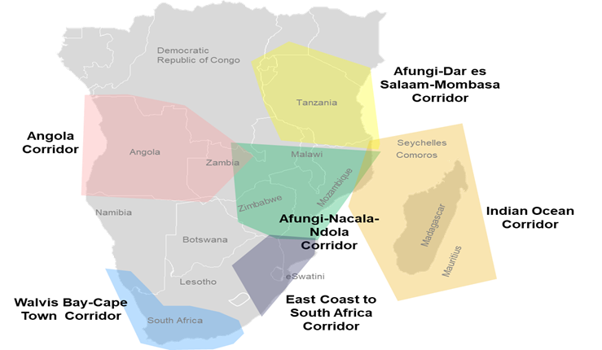
RGMP - Proposed Gas Infrastructure Projects
Source: SADC Regional Gas Master Plan

Slide 16
Gas Infrastructure Projects Identified on the Identified Corridors

Slide 17
RGMP Hard Infrastructure Along Corridors
1. East Coast to South Africa Corridor
  Floating, Storage and Regasification Units (FSRUs) at Matola & Richards Bay
  Pipeline from Port of Matola to ROMPCO pipeline
  Power infrastructure from Beluluane to the Motraco line
2. Afungi-Nacala-Ndola Corridor
  Pipeline from Afungi to Nacala
  Commission GTP plants in Afungi & Nacala
3. Afungi-Dar es Salaam-Mombasa Corridor
  Pipeline from Afungi to Madimba, and
  Pipeline from Dar es Salaam to Mombasa

Slide 18
RGMP Hard Infrastructure Along Corridors
4. Angola/ DRC Corridor
  Commission GTP in Soyo of additional 720 MW
  Commission GTP in Lobito of 1200 MW
  Power infrastructure investment
5. Walvis Bay-Cape Town Corridor
  Commission GTP in Elizabeth Bay
  Power infrastructure investment
  Pipeline from Oranjemund to Saldanha Bay to Cape Town
6. Indian Ocean Corridor
  Soft Infrastructure: National IEPs should consider all energy options, including gas.
  Oceanic Member States are recommended to analyse the possibility of LNG supply for power, while also investigating the use of LPG.

Slide 19
6 Key Enabling Dimensions to realise the RGMP Infrastructure Blueprint
Draft Final SADC RGMP identified the following key enablers:
Policy Convergence that take into consideration promotion of regional integration, security of energy supply, diversification of the regional energy mix, Promotion of industrialisation and emerging energy transition;
An Enabling Regulatory Framework – a critical role for the energy regulatory institutions at national and regional (RERA) level to protect the consumers while ensuring sustainability of the energy supply industry;
Market Development with fair and transparent pricing which addresses national and regional needs and currency risk

Slide 20
6 Key Enabling Dimensions to realise the RGMP Vision and Infrastructure Blueprint cont’d
identified the following key enablers:
Capital and Investment – required for hard infrastructure to be developed through ventures and by enable involvement of the DFIs and the private sector. It is estimated that US$17 billion of investment will be required to develop a regional gas economy within the SADC region;
Facilitating gas-based industrialisation through petrochemicals – promotion of gas-based industrialisation using affordable indigenous resources;
Development of a Highly Skilled and Innovative Workforce – to enhance Technical Skills and by Sharing knowledge and experience

Slide 21
6 Strengthening of the Regional Gas Institutions
Draft Final SADC RGMP recommended establishment of a Regional Aggregator will initially be limited to that of a brokerage function but should be expanded upon as the regional market develops;
The experience of SAPP in coordination and operation of the competitive electricity markets will critical in exchanging knowledge;
institutionalisation of the Regional Gas and Petroleum Association (REPGA) as forum to exchange knowledge and experience on gas issues; and
Recommended setting up a Regional Integration Energy & Gas Infrastructure Fund for the RGMP (ring-fenced within the existing facilities hosted by e.g. PPDF hosted by DBSA etc);

Slide 22
Role of Regional Organisations on Implementation of RGMP
The SADC Secretariat is expected to coordinate Inter-State (Regional) Gas Committee to facilitate cooperation between Member States in the regional gas market and enabling the implementation of the RGMP
RERA in its (current or) future structure will have to:
  Implement rules for participation within the Regional Aggregator and monitor and evaluate compliance with market rules;
  Oversee and regulate regional energy trade and facilitate the harmonisation of regulatory policies, legislation, standards, and practices.
  Provide a forum to mediate disputes over access to facilities relating to cross-border trade

Slide 23
Role of Regional Organisations on Implementation of RGMP cont’d
SAPP is expected to play an important role in enabling the RGMP by enhancing the ability of regional GTP projects;
Facility establishing and operationalising an innovative and sustainable financing mechanism for hard and soft infrastructure;
SACREEE to support alignment of RGMP to the regional renewable energy projects in order to ensure that natural gas plays a role in transitioning the region to a zero-carbon future;
KGRTC to play a significant role in building capacity in the region to develop a regional gas industry

Slide 24
Energy Ministerial Decisions Nov. 2022
At their meeting held on 04 Nov. 2022, in Kinshasa, DRC Ministers:
  noted the outcomes of the validation workshop for the Regional Gas Master Plan Phase II and requested to submit additional comments after undertaking consultations at national level;
  approved, in principle, a Regional Gas Master Plan as gas infrastructure investment blueprint and directed the Secretariat to ensure that the final Plan, incorporates comments from Member States; and
  recommended to Council to endorse the final Regional Gas Master Plan developed as gas infrastructure investment blueprint for the Region.

Slide 25
Summary of Progress and Remaining Actions on Development of RGMP
37th Summit in August 2017 directed the Secretariat to coordinate inclusion of Gas in the regional energy and promotion of Industrialisation
RGMP Phase I undertaken to explore availability of Gas in the Region
RGMP Blueprint for infrastructure was developed and approved in Nov 2022
High level Ministers Workshop in July 2018 recommended cooperation in development of gas Infrastructure and markets
Finalise RGMP for consideration and approval by Council and subsequent adoption by Summit

Slide 26
Conclusions and the Way forward
Increasing utilisation of natural gas a low carbon form of energy will enable transition from an energy sector dominated by fossil fuels to one based on renewable energy sources
Natural gas is a key transitionary fuel, contributing towards reductions greenhouse gas emissions while providing dispatchable power cost-effectively and reliably to energy systems;
Furthermore, natural gas can facilitate longer term industrialisation as a petrochemical feedstock, and as a reliable and cost-effective industrial heating source;
The recent discoveries of natural gas in Mozambique, Tanzania, Namibia and South Africa are likely to place the SADC region at the landscape of the global Liquefied Natural Gas (LNG);
Present final RGMP to Council to endorse is as gas infrastructure investment blueprint for the Region

Slide 27
Moitu Obrigado – Merci – Thank You

