Slide 1
IRSEA
Instituto Regulador dos Serviços de Electricidade e de Água
Conferência Anual da RERA/RERA Annual Conference
Transição para Energias Limpas e Renováveis
(Transition to Clean and Renewable Energy)
Palmeiras Suites Hotel, 14 – 15 December 2022, Luanda - Angola

Slide 2
Conferência Anual da RERA
Transição para as Energias Limpas e Renováveis
IRSEA
Experience as an Independent Power Producer (IPP)
Gonçalo Anacoreta
Luanda, December 2022

Slide 3
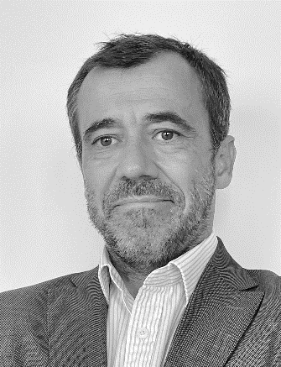
Conferência Anual da RERA
Transição para as Energias Limpas e Renováveis
IRSEA
Biografia/Biography
Foto/Picture
Nome/Name: Gonçalo Anacoreta
Empresa/company: TotalEnergies
Posição/Position: Renewables Business Development
Trajectória Profissional/Career Path:

Slide 4
Conferência Anual da RERA
Transição para as Energias Limpas e Renováveis
IRSEA
Agenda
TotalEnergies challenges worldwide
TotalEnergies presence in Africa
The renewables goals and approach
The Africa portfolio
The Quilemba project

Slide 5
Conferência Anual da RERA
Transição para as Energias Limpas e Renováveis
IRSEA
Energy is reinventing itself, so are we
TotalEnergies’ purpose is to supply more affordable, more available and cleaner energy to as many people as possible

Slide 6
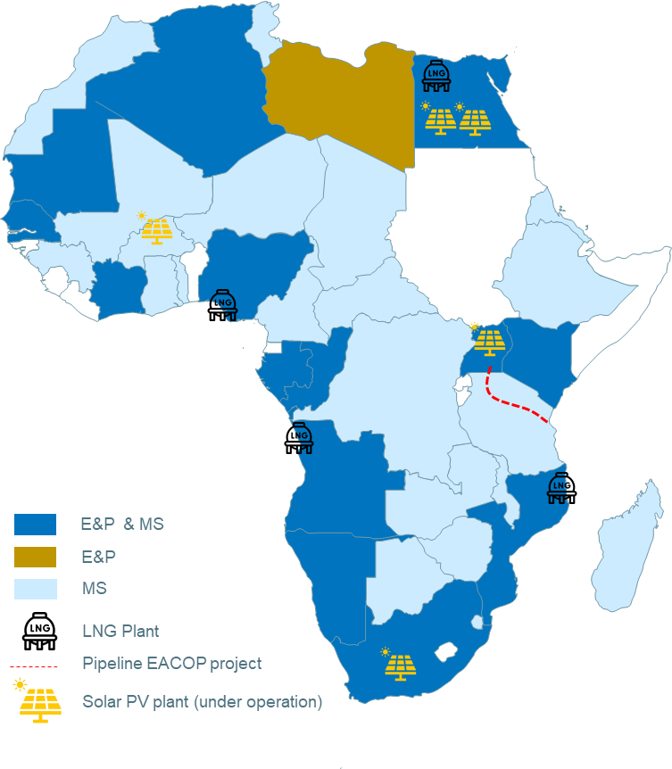
Conferência Anual da RERA
Transição para as Energias Limpas e Renováveis
IRSEA
TotalEnergies in Africa
Multi-energies in a glance
Active in 40 Countries
Leader with 16% of Market Share in 2021 for petroleum products
Close to 4600 Service Stations in 40 countries
600 MW of Renewable Energy Portfolio (100 MW installed)
Plating of more than one million tree on the Batéké Plateaux
In terms of Oil & Gas
19% of the company’s PRODUCTION
16% of the company’s proven RESERVES
30% of the company’s BUDGET EXPLORATION
1st DEEP OFFSHORE operations
In terms of Renewables
5 photovoltaic solar plants in operation
Several solar plants under development
Carbon Neutrality initiatives
Reducing flaring
Reduce fuel gas consumption though efficiency
Minimizing new projects’ emissions

Slide 7
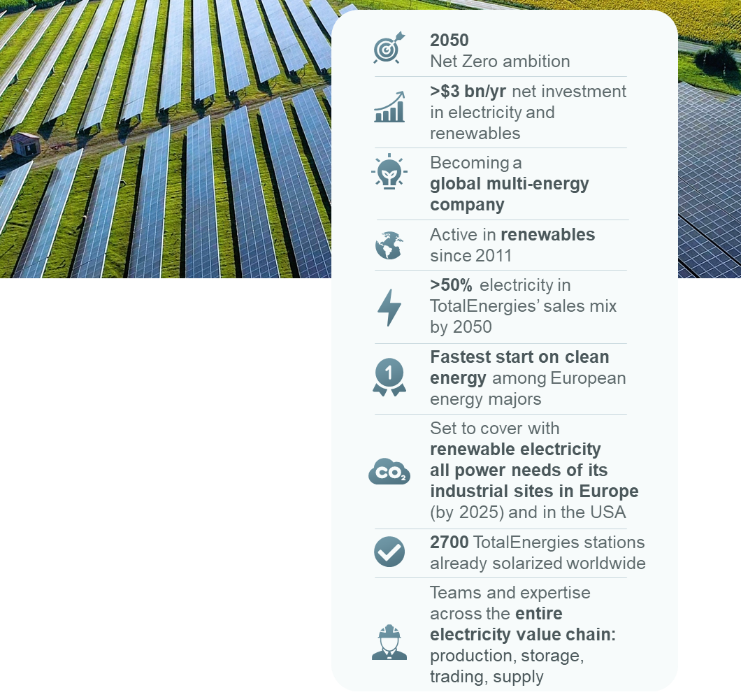
Conferência Anual da RERA
Transição para as Energias Limpas e Renováveis
IRSEA
Getting to net zero:
more energy less carbon
Becoming one of the top 5 Renewable players
Gross capacity
>10 GW*
35 GW
100 GW
2021
2025
2030

Slide 8
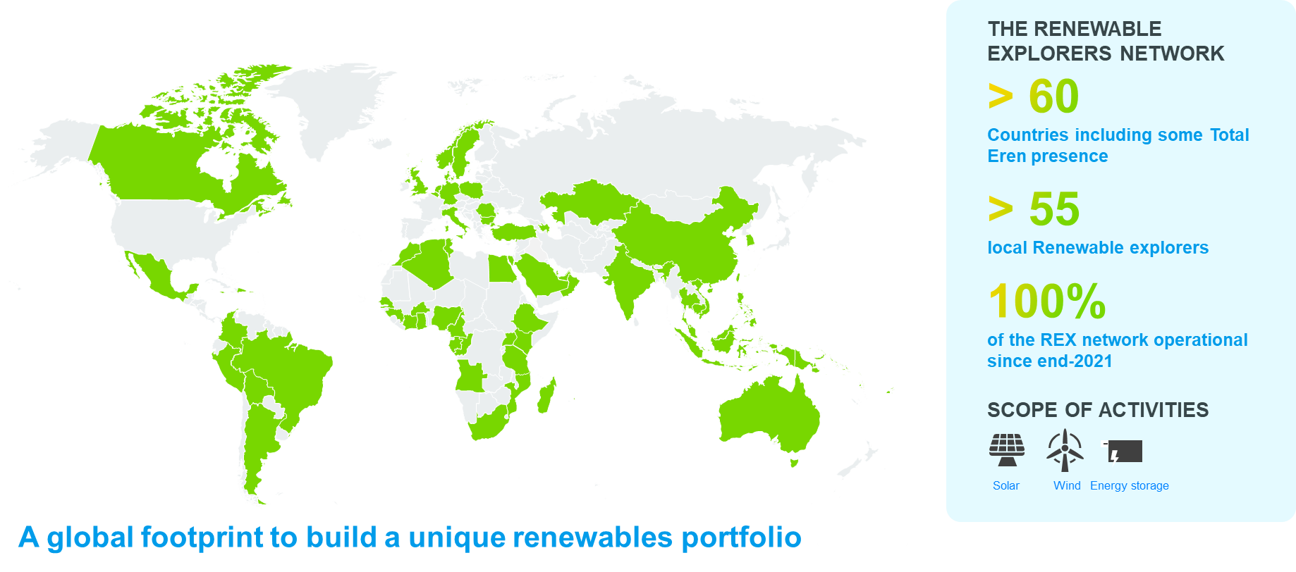
Conferência Anual da RERA
Transição para as Energias Limpas e Renováveis
IRSEA
Beyond 2025:
leveraging the Company’s worldwide presence

Slide 9
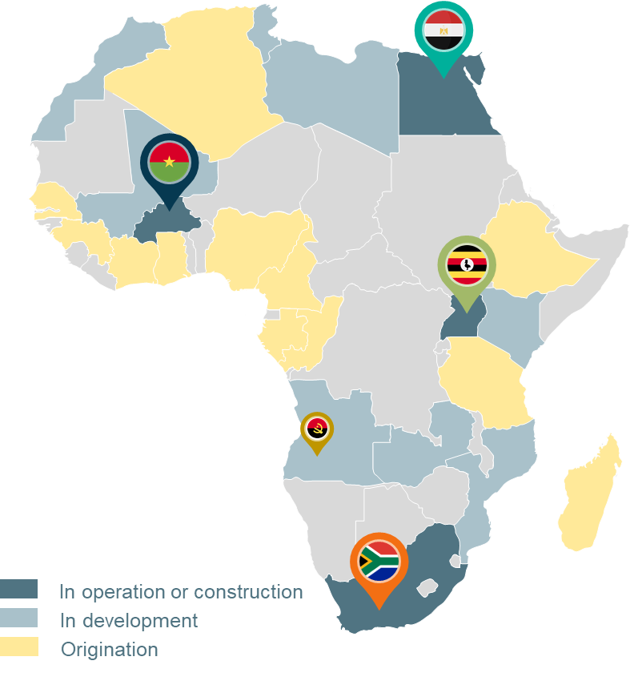
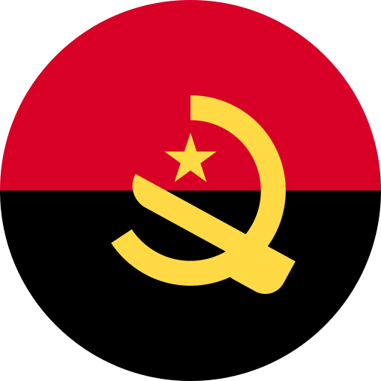
Conferência Anual da RERA
Transição para as Energias Limpas e Renováveis
IRSEA
TotalEnergies Renewable in Africa
Photovoltaic power plants in operation
Egypt | BENBAN (2 x 63 MWc)
Burkina Faso | ESSAKANE (15 MWc)
Uganda | SOROTI (10 MWc)
South Africa | PRIESKA (86 MWc)
Several projects at development stage, one in Angola
Angola | QUILEMBA (35 MWc)

Slide 10
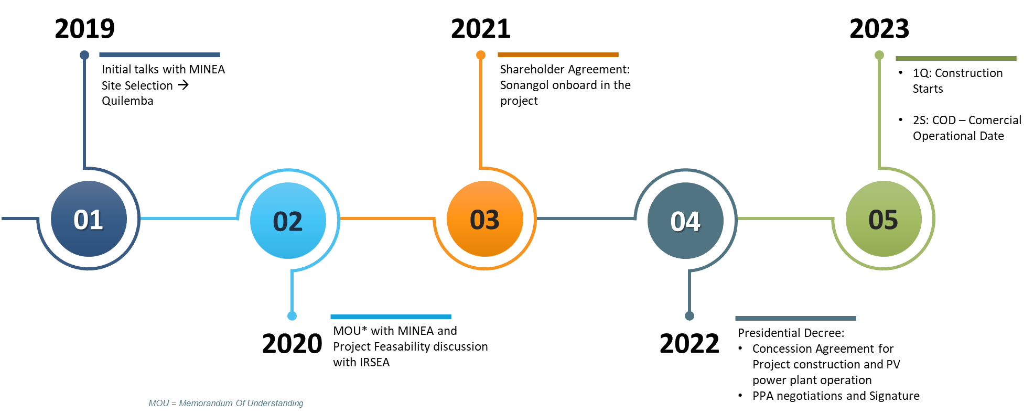
Conferência Anual da RERA
Transição para as Energias Limpas e Renováveis
IRSEA
Quilemba Solar project
Project milestones

Slide 11
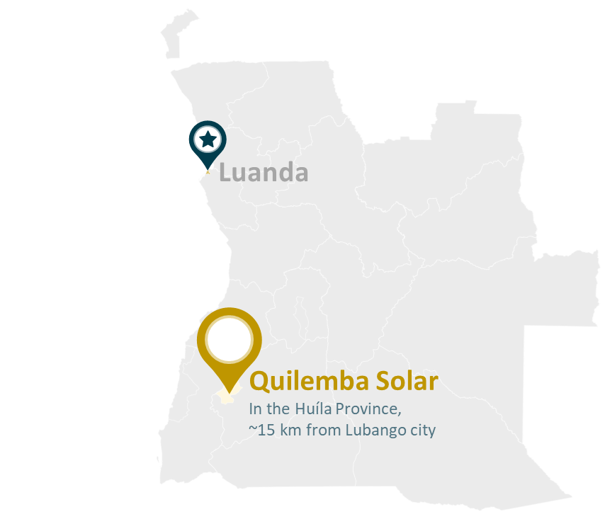
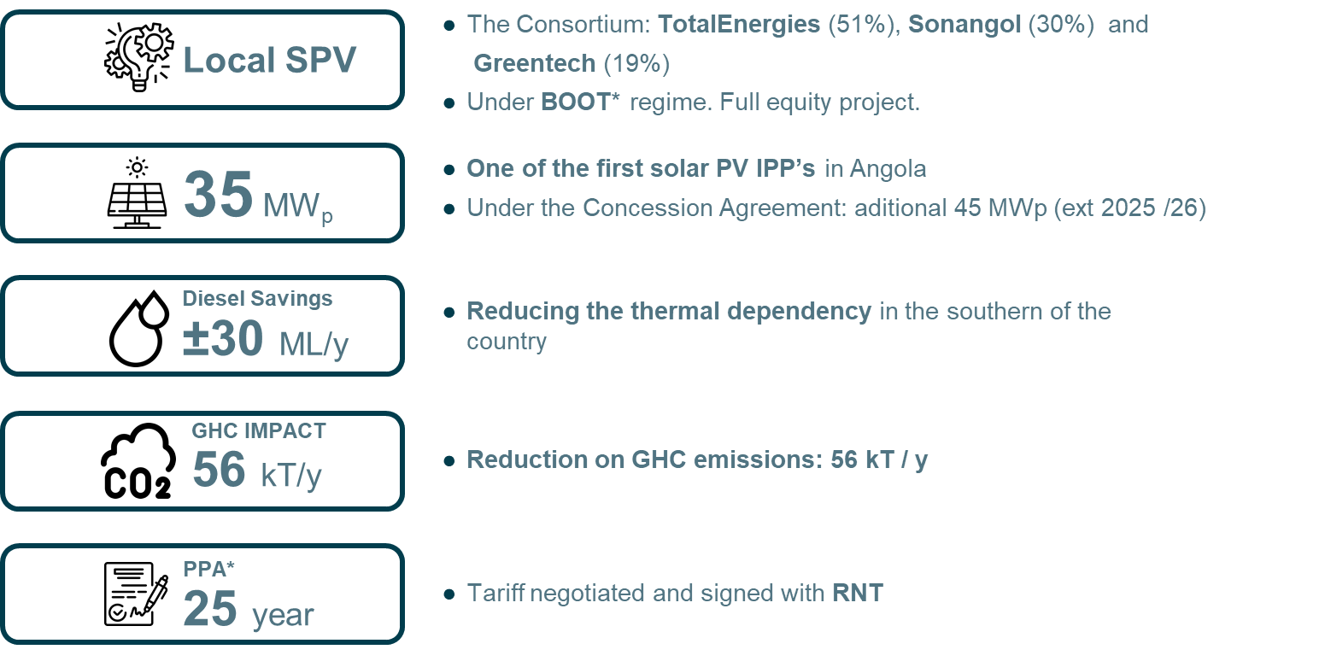
Conferência Anual da RERA
Transição para as Energias Limpas e Renováveis
IRSEA
Quilemba Solar project
Main figures

Slide 12
Conferência Anual da RERA
Transição para as Energias Limpas e Renováveis
IRSEA
Thank You Obrigado Merci Beaucoup Asante Sana

