Slide 1
Regulation of Renewable Energy (RE): Challenges and Options
Rojas Manyame
General Manager: Technical Regulation
14 December 2022

Slide 2
TABLE OF CONTENT
Introduction
Renewable Energy (RE) Challenges and options
Licensing
Economic and financial issues
Technical Issues
Omburu Solar PV Plant Highlights
Conclusion

Slide 3
Electricity Control Board - Mandate
Derived from the Electricity Act no 4, of 2007, Section 3 sub section (1)
to exercise control over and regulate the provision, use and consumption of electricity in Namibia.
to oversee the efficient functioning and development of the electricity industry and security of electricity provision.
to ensure the efficient provision of electricity
to ensure a competitive environment in the electricity industry in Namibia with such restrictions as may be necessary for the security of electricity provision and other public interest
to promote private sector investment in the electricity industry
In accordance with prevailing Government Policies.
Notes:
Our mandate is derived from the Electricity Act, Act no 4 of 2007….

Slide 4
Core Regulatory Areas
Technical Regulation
Ensure technical compliance of licensees
Technical / Infrastructure standards development and implementation
Technical compliance audits and inspections
Economic Regulation
Tariffs setting and approval
Financial viability and sustainability of the ESI
Licensing
Oversight and approval of Generation, Transmission and Distribution infrastructure projects
Issue, amend, transfer, maintain and cancel licenses

Slide 5
Regulatory Tools
Electricity Regulations: Administrative
Transmission and Distribution Grid Codes
Renewable Energy Grid Code (under promulgation)
Safety Code
Quality of Supply and Service Standards
Performance Framework
Technical Rules
Economic rules
Net Metering Rules
Distribution Infrastructure Standards
Low Voltage Electrical Installations and Wiring Standards

Slide 6
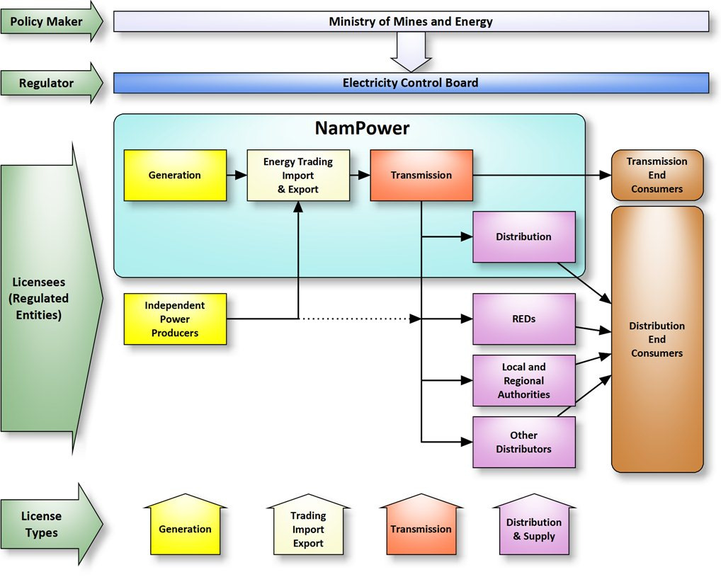
Namibian ESI Market Structure

Slide 7
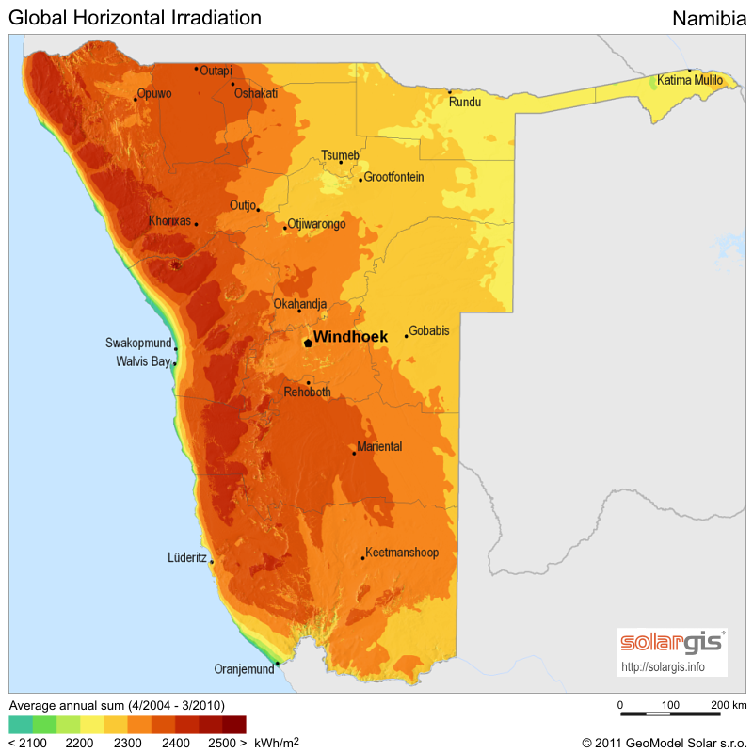
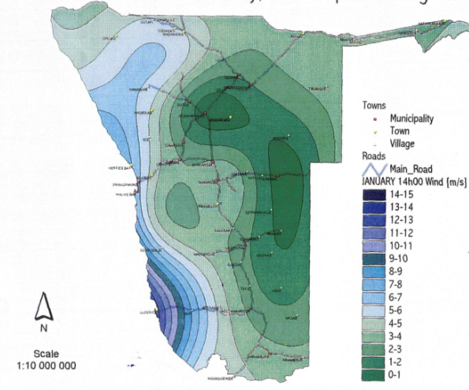
Namibia Solar and Wind Resources
Namibia is blessed with abundant RE resources

Slide 8
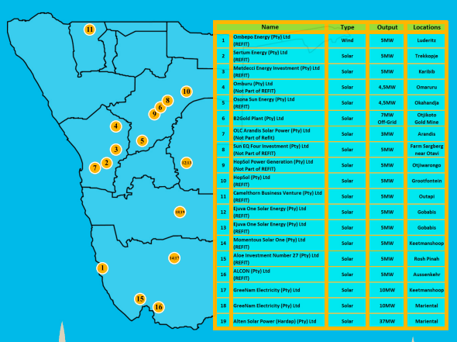
RE Plants Map Location Namibia
20
20 NP Omburu Plant Solar 20MW Omaruru

Slide 9
Licensing Highlights (1/2)
Licensing one of the core functions of the ECB
Cross-cutting over all departments
Includes renewables and off-grids
Legislation: Electricity Act No 4 of 2007
In accordance with the Electricity Act, Act No 4 of 2007, section 17, no person may establish or conduct any generation, trading, transmission, supply, distribution, import or export of electricity without a licence (unless formally exempted under the Act)
Despite section 17,
a license is not required if a generating plant has an installed capacity of less than 500 kVA, generates electricity exclusively for own consumption
Electricity regulations: Administrative, 2007
Applications for issue, renewal, amendment and transfer of licence
Application for exemption
Advertising
Objections
Fees for issue, renewal, amendment and transfer of licence or exemption
Register of licence and other information

Slide 10
Licensing Highlights (1/2)
Licensing Challenges
Licence lead time – 3-6 months target is to reduce to less than 3 months
Quality of licence applications
Implementation of projects as per the Licence
Full automation of licensing process

Slide 11
Generation Licenses Issued to date
License | Licenses Issued
REFIT MSB Gensets NamPower Other IPPs Rooftops Total Total RE MW | 14 20 13 7 13 5 72 188MW

Slide 12
Tariff Highlights (1/2)
All tariffs approved by the ECB
IPP to private - own tariff with ECB oversight
Public entity - regulated tariff
IPP tariffs to public entities capped at NamPower tariff

Slide 13
Tariff highlights (2/2)
Share of RE in Generation Mix vs Revenue Requirement
Revenue Requirement (N$) | %
RE Plants | 40
Other Technologies | 60
Total | 100
Generation MWh | %
RE Plants | 26
Other Technologies | 74
Total | 100

Slide 14
Technical Highlights (1/2)
In 2018, the ECB carried out a study on the grid integration of Intermittent Renewable Energy (IRE)
Resulted from industry concerns on the potential impacts that IRE can have on the power network.
The study concluded that:
IRE should not exceed a load demand of 300MW-350MW or 50% of its midday load.
IRE should be consumed in local distribution networks to avoid transmitting power over long distances to counter high losses
IRE capacities should be kept less than 10MW per connection point to avoid power quality violations
. In 2019 the ECB developed a standalone RE Grid Code;
due to increasing RE generation in the country,
It is currently undergoing promulgation

Slide 15
Technical Highlights - Challenges (2/2)
Variability and grid stability
RE variable power absorbed by BESS also
Cheap SAPP off-peak power purchased and stored in BESS for peak release
NP embarked on a 58MW/75MWh BESS project
Funded by KfW and tendering is in progress
ECB developed storage framework including regulation
Licensing done using generation licensing
Quality of supply challenges for large plants
Issues of harmonics,
Sometimes need for expensive mitigatory equipment

Slide 16
Technical Highlights - Challenges (2/2)
Network technical constraints requiring detailed studies.
Capacity over-installation of plants by some IPPs
Installed capacity greater than Licensed capacity
Overcapacity energy pegged at NP tariff or forfeited

Slide 17
Namibia National Integrated Resource Plan (NIRP) and RE
Namibia has just completed reviewing its NIRP
The Plan was approved by cabinet in October 2022
Line Minister to implement the Plan through ministerial determinations
Plan has several implementation scenarios
The recommended scenario targets renewables to be 70% of the generation mix by 2030

Slide 18
Omburu Solar PV Plant Highlights (1/3)
NamPower applies for tariff reviews annually
Tariffs are cost reflective
Long Run Marginal Cost (LRMC) fund included in tariff for years when tariffs are very low
Meant to ensure smooth tariff path
Cushion customers from unexpected tariff hikes
LRMC ringfenced fund within NP
Regular reporting on it to the regulator
In 2020 N$500million of LRMC was allocated to NP for renewable energy plants

Slide 19
Omburu Solar PV Plant Highlights (2/3)
In line with the National Integrated Resource Plan (NIRP) 2016, the Minister of Mines and Energy issued a Ministerial Determination for generation projects for 220MW
NP was allocated 150MW and IPPs 70MW
NP’s basket of projects amounting to 150MW included
20MWp Solar PV
40 MW Wind
40MW Biomass
50MW HFO
The ECB released N$500million from LRMC Fund for some of the above projects
Omburu 20MW solar PV plant was one of the beneficiaries
Allocated N$342million and balance N$158million to wind project

Slide 20
Omburu Solar PV Plant Highlights (3/3)
The 20MW solar PV plant is located near Omburu substation hence its name Omburu
Construction started in March 2021
Project completion was in June 2022
Total cost of project was N$342million
Benefits to the customer
Customer funded hence no return to NamPower
Reduced overall tariff

Slide 21
Conclusion
Namibia has a clear RE roadmap
RE Regulatory tools are in place
RE forms part of the energy mix in the NIRP
Innovative RE Integration always being sought
Through the reform and development of the Modified Single Buyer (MSB) model, about 450MW of RE equivalent capacity can be developed by Private Sector

Slide 22
Thank you!
Notes:
Thank you!

