Slide 1
POWER QUALITY IN THE WORLD OF RENEWABLE IN PLANTS
Presented by: Izaias Lot Ndapona
NamPower
DATE: 14 December 2022

Slide 2
Presentation Overview
NamPower Map Overview on PQ
NamPower Approach on PQ (system wide)
Approach Renewable Energy Integration
Cases
Take Away

Slide 3
Why Power Quality?
Every product’s quality need to be measured and quantified.
Electricity is a product; thus, it is essential to measure the quality of electricity supply to our customers.
Helps with the health status of our network, the grid is a patient with symptoms.
If symptoms are not treated, then fixing may become costly and the tariff becomes unaffordable.
Untreated symptoms i.e., harmonics leads to revenue loss
Enabling factor is having and enforcing standards hence the importance of a regulator in the electricity market.

Slide 4
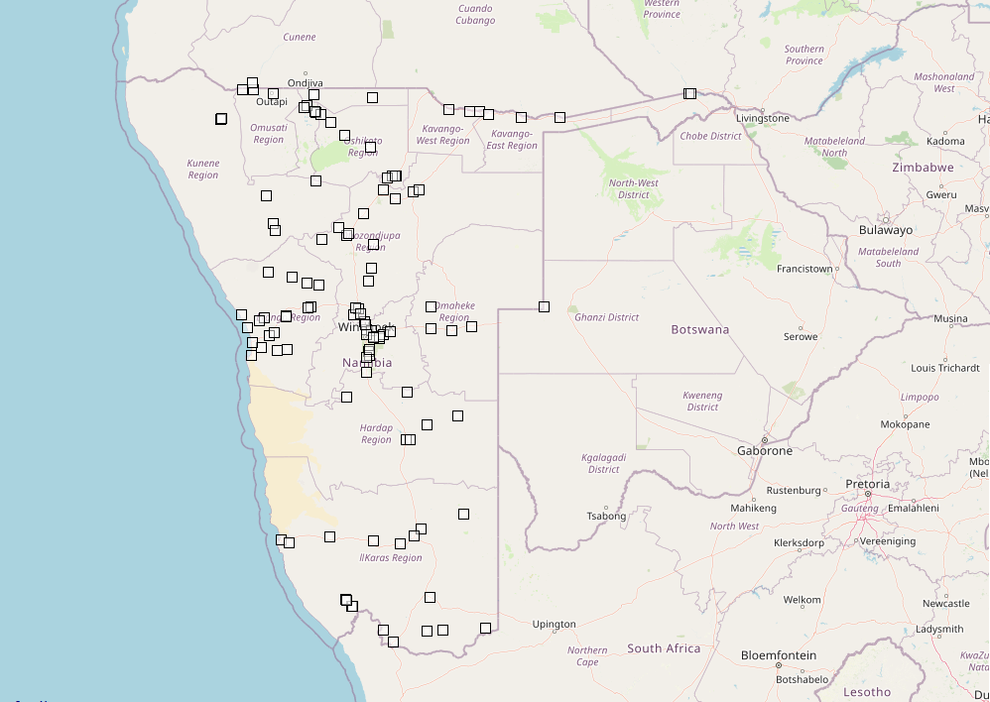

Slide 5
Where do We monitor?
System wide: 230 power quality meters strategically installed
Critical areas on back-bone within Tx system
Tx customers interfaces at 132kV , 66kV, 33kV, 22kV, 11kV.
Inter-connectors at 220kV and 400kV.

Slide 6
VALUE OF PQ MONITORING
Planning
- Background data ( new connections or studies) i.e. harmonics on PCCs
Protection
- Fault clearing time investigations
- Voltage regulations ( AVR set point revision)
Customers
- Compliance on Grid Code Requirement and regulatory standards
PQ / QoS
System / Network operations
- Sites with no Scada visibility (i.e. Trfrs 2.5MVA and less)
- Tap-changer lock-out
Maintenance
- Proactive tool, i.e. input for tree trimming (dips)
Electricity Control Board
- Annual PQ reports & adhoc
SAPP
- Monthly PQ reports on inter-connecters.

Slide 7
Approach On Renewable Energy Integration
Pre-Integration
Application is made
Renewable energy plants are site and size depended
Background Harmonics (minimum 6months historical) and Frequency Sweeps
Applicant’s grid compliance report and Plant model submission to NamPower
Analysis of the plant report vs Plant simulation results
Intermittency and system response thereof

Slide 8
Approach On Renewable Energy Integration
Integration
Plant Energization
Verify Harmonics content on the energization day (spot check)
Compliance testing according to grid code standards
Tested for:
Voltage Control response / Reactive power control
Power Factor control
Active Power control
Protection operation/ Islanding detection test
Harmonics pollution (measure 14days) post COD.
Night support (STATCOM) testing for 10MW and above

Slide 9
POWER QUALITY STANDARDS
IEEE 1159 – recommended practices for monitoring PQ and controlling harmonic in power systems
IEC 61000-4-30 – power quality measurement methods
IEC 61000 -2-2 to 12 for compatibility
NRS048- series

Slide 10
PQ Parameters on RE
RE plants tied to the grid must conform to the Grid-Code requirements.
Post compliance testing, RE are monitored for all parameters of power quality.
Voltage magnitude and regulation
Voltage unbalance
Voltage Harmonics
Voltage flickers
Voltage Dips (ride through capability)
Class A instrument is used for pre-integration, during testing & post testing
Every third year, the RE plants undergoes compliance retesting.

Slide 11
Current State of RE on the grid
NamPower fully owned and operated
1 X 20MW
Renewable Energy Feed-in Tariff (REFIT) with a 5MW capacity each
15 X Solar PVs capacitated with 5MW
1 X wind plant
Independent Power Producers (IPP)
2 X 10MW
1 X 37MW
1 X 5MW
Embedded Generation (behind the meter)

Slide 12
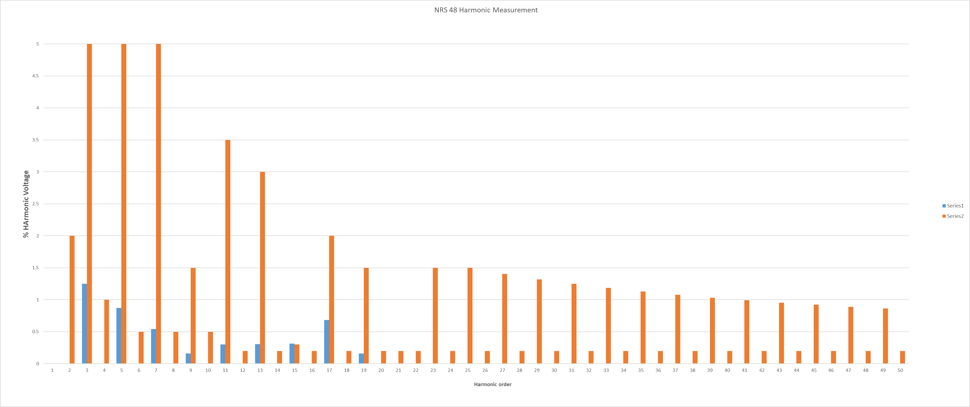
Cases

Slide 13
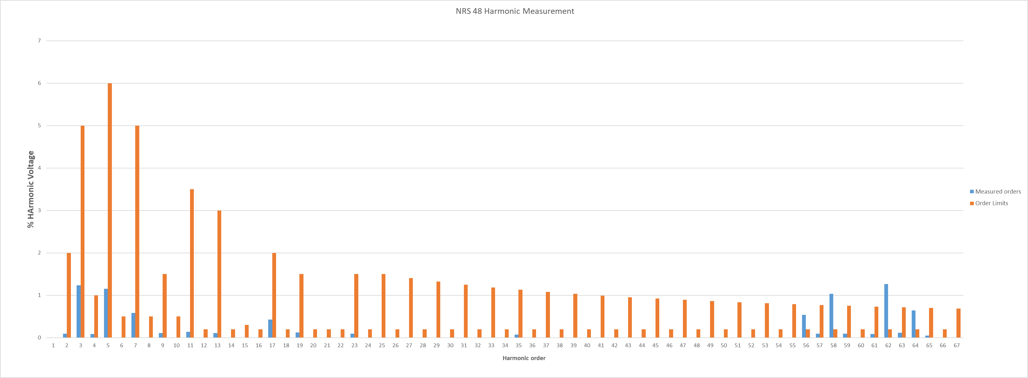
Cases

Slide 14
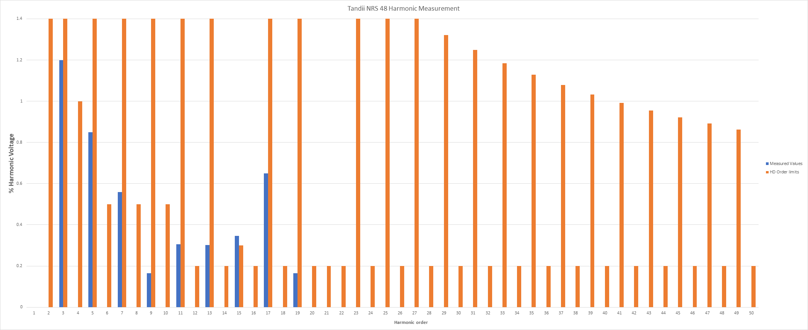
Cases

Slide 15
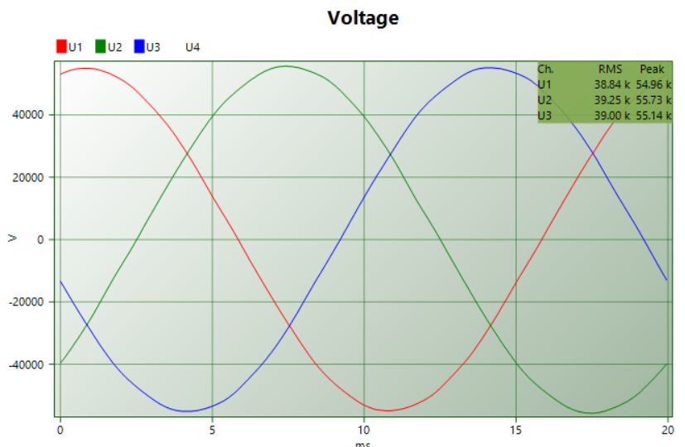
Before PV

Slide 16
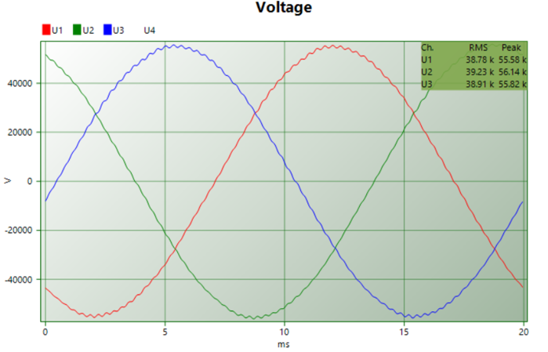
A case of high orders

Slide 17
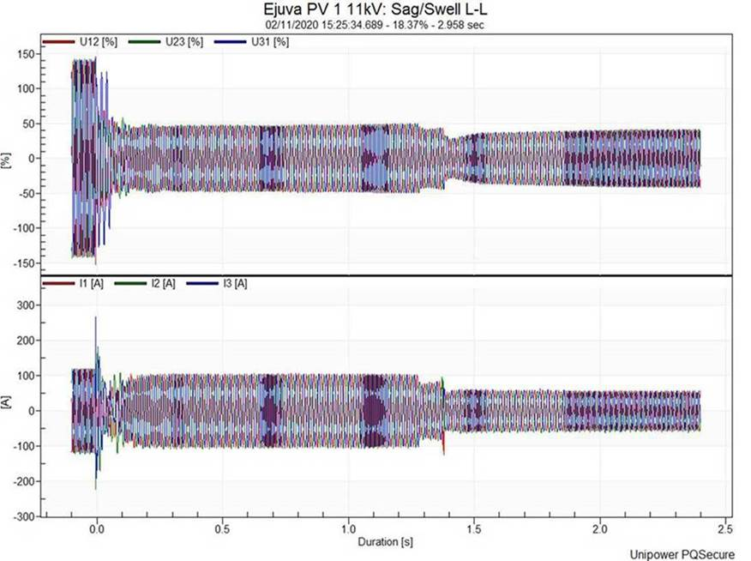
Cases continues
Islanding problems

Slide 18
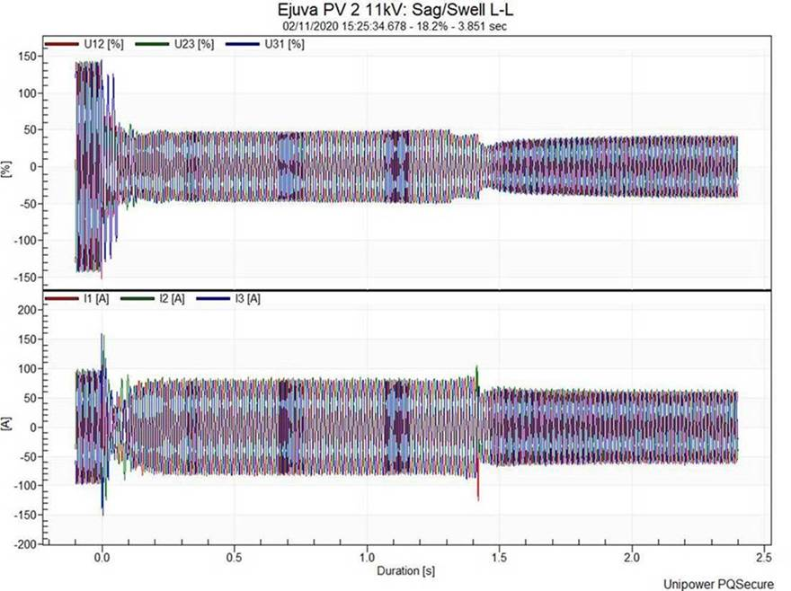
Cases continues

Slide 19
Take aways
RE world is here now and forever for as long as the climate allows
Renewable integration requires good historical system information
Correct Power Quality measurements enables proper RE integration
Inverter designers must be truthful to their customers
Change in switching frequency on RE plants have effects on power systems
Carefully monitoring is required to keep RE compliance
Harmonics and intermittency are the most worrisome anomalies associated with RE
RE placed at weaker nodes in the network may cause instability
Poor power quality can cost you money that leads to loss of revenue
Standards are key to successful implementation and monitoring
Always important in the ESI:
to measure is to know and knowing enables right action.

Slide 20
Thank you

